Slide 1
WHERE FOUNDERS & INNOVATION THRIVE
IMPACT 307
Increasing Entrepreneurial Services in Wyoming
Brian Young
Assistant Director
Central Wyoming

Slide 2
The UW Business Resource Network
SBDC (Small Business Development Center)
Manufacturing Works
Tech Transfer
IMPACT 307

Slide 3
IMPACT 307
EDA Grant Overview

Slide 4
U.S. EDA CARES Act Grant
$2.4 million grant to expand IMPACT 307 programming to underserved regions of Wyoming
3 Assistant Director positions created regionally
Providing business mentorship and advising statewide
Virtual incubator model
Additional physical business incubator locations

Slide 5
U.S. EDA CARES Act Grant
Services aligned with regional community college districts
Work closely with local economic development organizations
Expand maker space availability
Adding 6-8 start-up challenge competitions over the next three years
Each start-up challenge funds 3-5 new businesses in community, plus several additional business starts

Slide 6
IMPACT 307
The Methods

Slide 7
IMPACT 307
Methods
Lean Launchpad (based on problem/solution/best customer)
Technology Readiness Levels & Business Readiness Levels
Partnerships within state and BRN

Slide 8
Start-up Challenge Successes
30-40 applicants per competition
3-5 winning companies
Work with many others
Overall, 5-year survivability rate is ~85%
Consistent with national averages

Slide 9
Expanding the Entrepreneurial Ecosystem –Youth Entrepreneurship
Buffalo High School Start-Up Challenge
UW and local contributions: $5,000 seed fund
Run similar to Local Start-Up Challenges
Expose students to entrepreneur opportunities – which will hopefully translate at college and beyond!
FBLA collaboration

Slide 10
IMPACT 307
IMPACT Fremont Overview

Slide 11
Fremont County Successes
Local Start-Up Companies
11 Companies Receiving Mentoring
Year-round Business Mentoring Programming
Start-Up Challenge Participants
Fremont County Start-Up Challenge
Targeted $50k Seed Fund
CWC Innovation Center at County 10 Building
3-5 Companies Started Annually
Utilize interns from CWC
Local Judges
$51,000 Subaward to CWC
Local EDO Engagement
IDEA Inc., LEDA, WRD

Slide 12
Fremont County Successes
Expand CWC Entrepreneurial Offerings
Workshops and Bootcamps
Entrepreneur Essentials (EE)
Expand Entrepreneurship Curriculum
Potential Incubator Space
CWC Bootstrap Innovation Center
Maker Space 307
County 10 At Work Coworking Space
Youth Entrepreneurship
High School Start-Up Challenge
CWC Student Involvement

Slide 13
IMPACT 307
IMPACT Goshen Overview

Slide 14
Goshen County Successes
Local Start-Up Companies
4 Companies Receiving Mentoring
Year-round Business Mentoring Programming
Start-Up Challenge Participants
Goshen County Start-Up Challenge
Raising $30k Minimum Seed Fund
Incubator Space at Goshen Economic Development
3-5 Companies Started Annually
Local Judges
$51,000 Subaward to EWC
Local Engagement
Goshen Economic Development
EWC Foundation

Slide 15
The Goshen County Plan
Expand EWC Entrepreneurial Offerings
Workshops and Bootcamps
Women’s Entrepreneurial Summit
Entrepreneur Essentials (EE)
Expand Entrepreneurship Curriculum
Work to Create Maker Space
Possible State Funding
Potential Sites Identified
Success Statewide
Youth Entrepreneurship
High School Start-Up Challenge
EWC Student Involvement

Slide 16
IMPACT 307
IMPACT Casper Overview

Slide 17
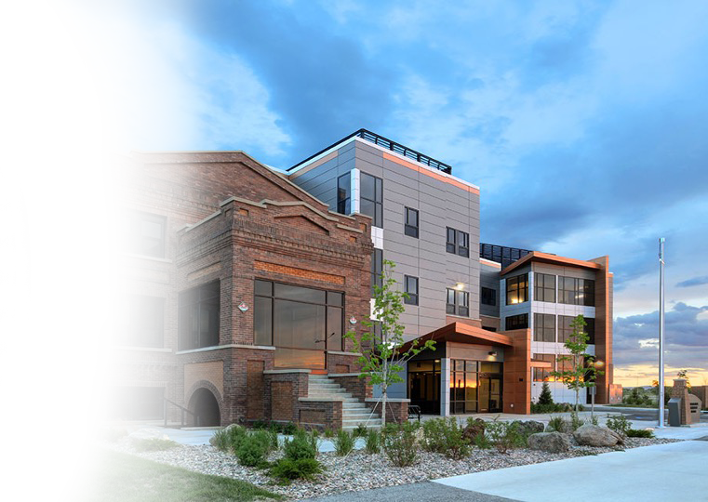
History of Casper Business Incubator
Former site of Amoco Refinery
Incubator facility built in 2012
CAEDA asked UW to take over and worked as a partnership
UW took over operations 2013

Slide 18
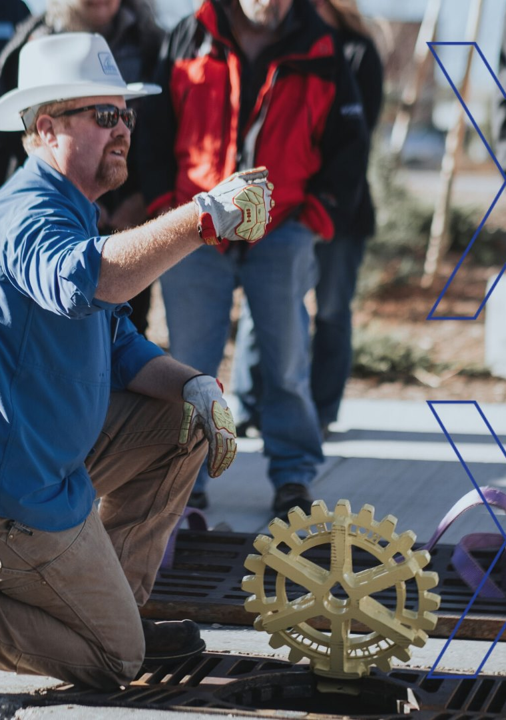
Casper Client Industries
Typical industries where new businesses are pursued
Outdoor Recreation
Consumer Products
Professional Services
Light Manufacturing
Oil/Gas
Medical Device

Slide 19
Casper Start-Up Challenge
Competitive event with $65,000 seed fund
Three rounds: initial application, semi-finals, final public pitch event (livestreamed last year due to COVID)
Average 35-40 applications/year
Great community support
All applicants, whether they progress or not in the competition, are offered start-up advising

Slide 20
IMPACT 307
Q&A

