Slide 1
Understanding the Building Blocks of Economic Development
Month Day, 2021

Slide 2
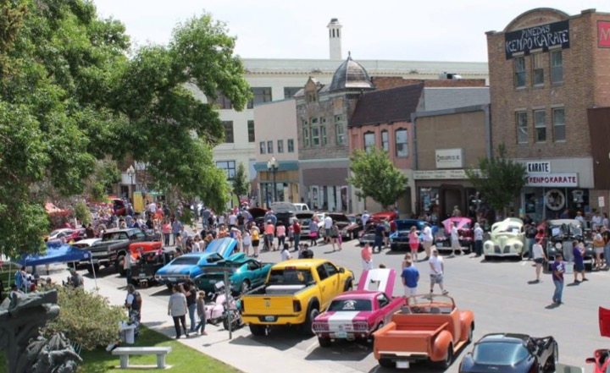
Economic Development in Wyoming
Notes:
Great Big Thank you to Ed McMahon for leading us through the discussion regarding the New Model of Economic Development and how we really start to look at how we can help our communities succeed. We want to take just a few minutes to focus specifically on Wyoming and how the principles he talked about are discussed, what successes we have had and how you can take some of what we are learning back to your community.

Slide 3
Building Blocks of Economic Development
Notes:
In Wyoming we have focused on the Building Blocks of Economic Development for many years. If many of these things look familiar, they should. They overlap very closely with many of the things that Ed just went through. Economic Development is a multitiered approach that takes partnerships and focus. As a rural state, and rural communities we have to focus on all of the pieces of the pyramid in order to be successful. We are going to very briefly walk through each of these and talk about some of the successes we have seen in the state in these blocks.

Slide 4
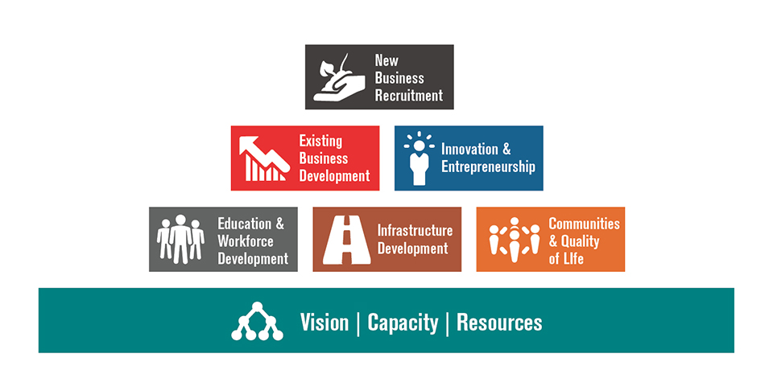
A Strong Foundation
Notes:
Ed Talked about how the 21st Century Model of Economic Development Is driven by and Overall Vision, it depends on public/private partnerships, it focuses on what you have instead of what you don’t have and that these are foundational to any successful community and successful economic development.
In the Wyoming Building Blocks you will see that indeed the foundation of any good economic development plan or process includes all of those things:
First we see that successful communities and regions have a Strong and Articulated Vision for what they want their community to be and it could become. This likely means that all of the key players in the community have had those conversations and are on the same page.
Second the community has focused on developing capacity. It has built strong public/private partnerships. It isn’t just a well trained economic development entity, it is also a committed and educated city and county, it is committed and educated elected officials and it is a commitment to the vision and to brining resources to the table. There is also a strong understanding of the leadership roles and who is doing what.
Finally, there is an understanding and use of resources. This means a couple of things:
First, the community, region, state, whatever, understands what assets it has and what it can build on. As Ed talked about, the most effective communities know where they are successful and where their assets are and focus there instead of focusing on what they don’t have.
Second, the community knows what resources they need to reach their vision, have identified potential resources and have committed their own resources to moving themselves forward. This might look like funding commitments, a case for support for projects.
Let’s look at a few local examples of communities that have focused here.

Slide 5
Vision, Capacity, Resources
7th Penney Taxes in Fremont and Goshen County
Notes:
Without Leadership, Nothing Else Matters
7th penney Economic Development Taxes are currently being used in two of our communities (Goshen and Fremont). This example is from the 2020 vote in Fremont County. This is a perfect example of setting a Vision, putting together a Public Private Partnership, and a helping a community provide its own resources to support economic development. Fremont County came together to really detail out the Vision it had and then created communications to really help the community understand the impact these resources would have.

Slide 6
Vision, Capacity, Resources

Slide 7
Quality of Life: Work Where You Want to Live
Notes:
Quality of Life
As Ed Pointed out, Quality of Life is Critical. In order to Grow and not die, communities have to be somewhere people want to live!!! We have some great examples of how some of our communities are working on their quality of life and thus, bringing people and jobs into their communities.
Quality of Life are all of the things that make our towns and Cities into communities and neighborhoods. It is providing places to gather, things to do, aesthetic environments, etc.

Slide 8
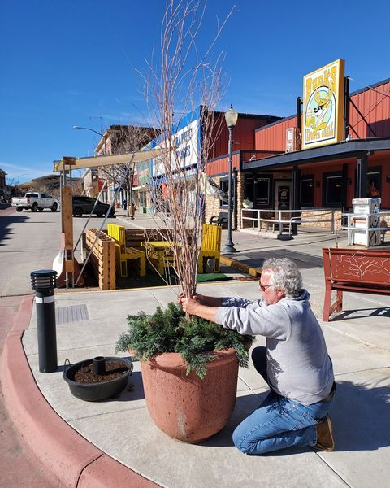
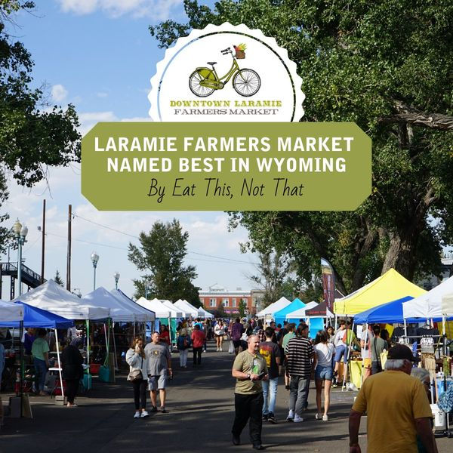
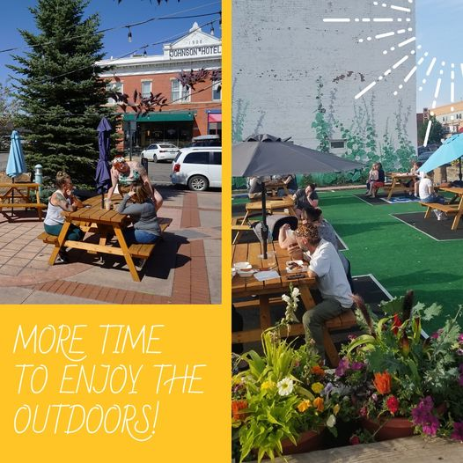
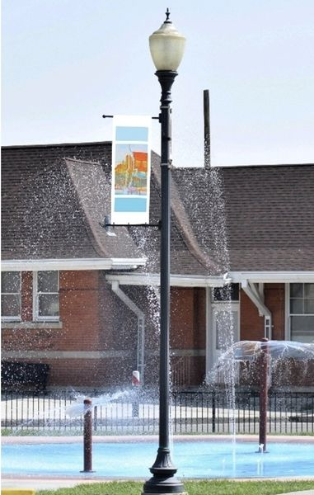
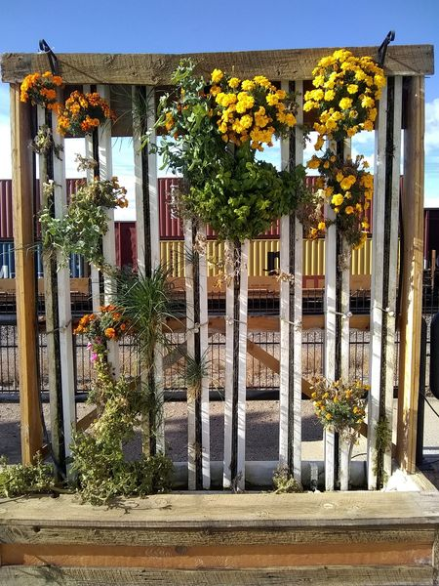
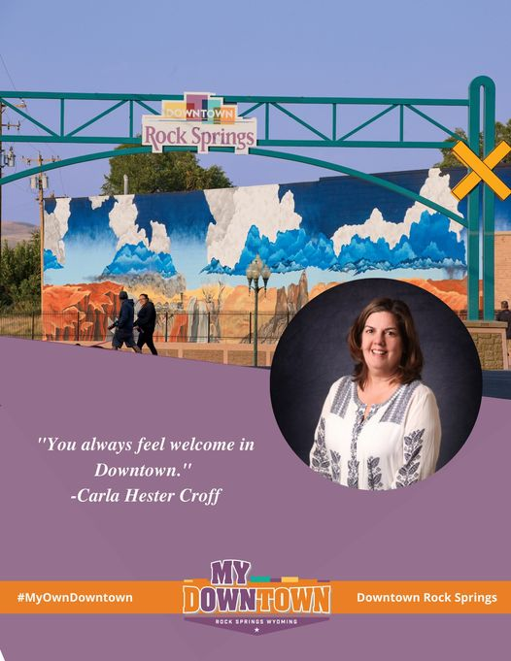
Quality of Life: Main Streets Makes a Community Worth Living In
Notes:
Main Street Programs -
Wyoming has many strong Wyoming Main Street Programs and while a focus on downtown is definitely not the only way to create a better quality of life, it is definitely a good place to start. Both Riverton and Rock Springs have been named Great American Main Street Programs by the National Main Street and have made huge progress in revitalizing their downtown areas and brining new people and businesses into the downtown area; however, there are some amazing projects happening across the state.
Redevelopment of old and abandoned buildings
Murals that enhance the environment
Pocket Parks
Community Enhancements
As Ed pointed out communities that focus on redeveloping the downtown in their community show a greater growth of

Slide 9
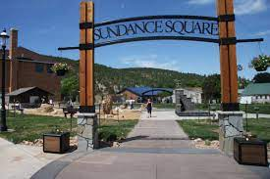
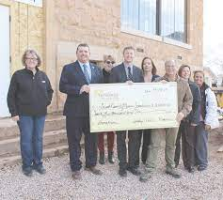
Quality of Life - Sundance
Notes:
Sundance set of Vision of restoring a historic building, Old Stoney. With the help of the Vision, strong Public Private support and a plan for moving forward, this small community was able to raise the funds and obtain grants to restore the building that drove the renovation of the area and created a fantastic community asset that has helped drive visitors and additional people to Sundance.

Slide 10
Workforce: Without Good Employees, Job Creation is Not Possible
Notes:
Workforce
Ed talked about having, Highly trained Talent. No economic development happens without people. New and growing businesses need people to help them succeed and while this has been a challenge both in Wyoming and around the Nation, there have been some strong projects across the state focused on how we keep our kids in the state to help our communities and our businesses succeed, how we educate and re-educate our workforce and how we draw new people in to work in the state.

Slide 11
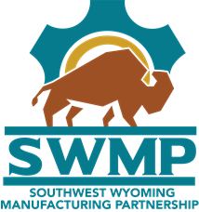
People, Skills and Work Ethic
Notes:
Next Gen Sector Partnerships
Over the last few years, various regions across the state have participated in a project called Next Gen Sector Partnerships. These groups bring industry in the region together to look at what they need to be successful as an industry. In the Southwest region which includes everything from Rawlins to Evanston and everything in between.
The Southwest Wyoming Manufacturing Partnership works to improve workforce development across southwest Wyoming by bringing together public and private sector leaders to support growing industries, build businesses, and connect people with better jobs.
On October 4, 2018, manufacturing industry leaders, representing a cross-section of the industry from Southwest Wyoming, came together to identify opportunities and actions needed to promote the growth of the sector. In addition, community partners from workforce development, education, and economic development attended as sector support partners. This partnership is modeled after similar partnerships across the country that are achieving real results for businesses, job seekers, regional economies, and businesses.
Focusing on two goals, the industry has successfully created very strong partnerships with both the K-12 system and Community College to help expose students to the industry early so they can begin to work on skills they would been and to create interest in joining that industry
Working with the community to enhance the “life skills” of young people growing up in the region, including shifting negative attitudes/perspectives such as “you need to go somewhere else for a career.”
Focusing on education in specific technical skills, from basic craft/mechanical and computer skills to advanced manufacturing skills such as distributed control/process control.

Slide 12
People, Skills and Work Ethic
Notes:
Other communities have taken more of a marketing approach to attracting people. Many of our communities are near larger population centers in other states.
Cheyenne Leads has created a workforce campaign that does a number of things. It puts billboards on the highway between Cheyenne and Fort Collins offering a better quality commute. They have also ramped up their outreach campaign to colleges and schools in region that talks about the jobs available in Cheyenne and the Quality of Life that Cheyenne offers that they may not be able to get along the Front Range.

Slide 13
Infrastructure:
Notes:
Infrastructure
What is infrastructure? When most of us hear this, we hear roads, sewer, etc; but ultimately, infrastructure is about making sure that the community has what the people and the businesses need on a basic level to live and do their jobs. It does include water, sewer and roads, but as Ed pointed it out, in today’s world it also includes making sure that there is access to high quality education that is providing the education that the workforce needs in your community. It is making sure that the people and businesses in your community have access to appropriate broadband.
For those of you in City and County, this is a key role for you in Economic Development. Working to make sure that regulations allow for what is needed by industry. Making sure you work closely with others in the community to put in the infrastructure needed to get to the vision and have the pieces in place.

Slide 14
Can you Connect?
Notes:
Broadband:
As an extremely rural state, Broadband is a huge economic development issue. If businesses can’t get the internet they need to do business, they will not come here. If people don’t have the access they want, they won’t live here.
The WBC has partnered with the Governor’s Office to leverage ARRPA dollars to create a more impactful Broadband enhancement program. It provides resources to communities as well as guidance and TA to help you think through where your gaps are, how you know that, what your options are for dealing with that and how you work to make a better internet and connected community for your people and your businesses.

Slide 15
“Shovel Ready”
Notes:
On the more traditional side of things, Casper has spent some significant time and resources improving Midwest Ave in the Old Yellowstone District.
The OYD has been undergoing a significant transformation the past 10 years.
The existing infrastructure on some of the streets did not meet the needs of the new businesses and attractions.
The growth in this area had outpaced the City of Casper's ability to prioritize and fund needed infrastructure improvements.
The State's new 3-story, 110,000 sq ft building sits on 11 acres and will be accessed from Midwest Ave when it opens in early 2022 and will generate significant vehicle and foot traffic in the surrounding area.
The infrastructure improvements include two 12' wide driving lanes; two 8-foot-wide parking lanes; a 5 - 6 foot boulevard on each side of the street; a 5 foot sidewalk on both sides; ADA ramps at all intersections; street lights along the entire corridor; improvements to an aged and inadequate sewer system; and expanded storm water drainage system.
This project was driven by a strong community vision that had staying power and has driven many businesses into the OYD and created more economic activity by driving people into the area and creating a place to be.

Slide 16
Existing Business: Grow Your Own
Notes:
Existing Businesses
Often referred to as “Business Retention and Expansion (BRE)” Programs
While it is tempting for economic developers to focus on the new and exciting relocation leads, the nuts and bolts of economic development reside in the businesses we already have. Many try to focus on the “big splashes” in our economy. As you see in the stats, 50 – 80% of job creation is within the existing core businesses in your community.
It makes sense as well. Each new job you create in an existing business, doesn’t require more public infrastructure, more traffic or more housing. Typically, this job growth draws employees from within the current job pool, helping employees to improve their earnings and enhance their lives.
Every community has its share of businesses which serve as the economic drivers of the community. As these businesses grow and expand, a ripple of economic benefit is felt throughout the community. Smart communities look at their core industry, analyze the best ways to grow upon their strength.
These same communities will also seek ways to diversify their economy in order to smooth out seasonal variations.

Slide 17
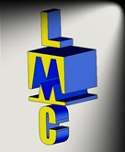
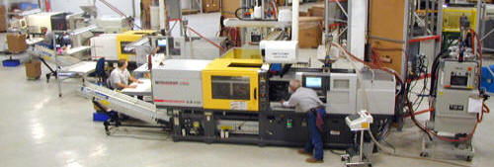
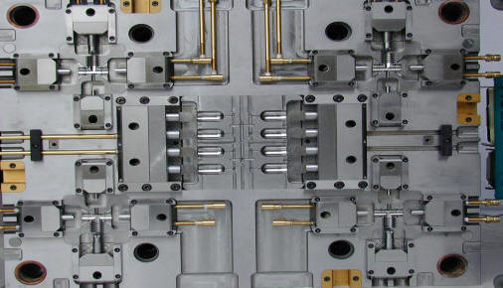
Vibrant Local Business
Notes:
Legacy is a injection molding company in Riverton Wyoming who focuses on providing rapid turnaround and problem solving for customers. They are able to make small lot production or major projects that ship all over the world. Legacy molding started in 2000 in Riverton, Wy and has grown substantially in the last twenty + years. This has been partially due to a strong relationship with the local community and IDEA Inc. Thought this partnership, they have been able to leverage state dollars to access an old dilapidated big box store in the middle of town that was falling down. Leveraging local and state dollars, they were able to renovate the building and move into part of it in order to expand their work. Since then, they have expanded into a good portion of the rest of the building and are working on putting in a new office area and more machines that will allow them to do different types of projects.
Legacy molding Inc.'s business has been expanding at a phenomenal rate. LMI has received increased orders of 100% - 300% from their top customers, which will continue for the foreseeable future. To meet this increased demand, LMI has increased their workforce from 25 to more than 50 employees, incorporated robotics, purchased millions of dollars of new equipment and has increased their plant size from 16K sq-ft to more than 40K sq-ft. This has been and will continue to be great economic development for the city of Riverton, Fremont County, and Wyoming.

Slide 18
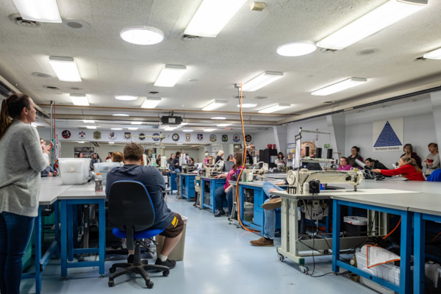
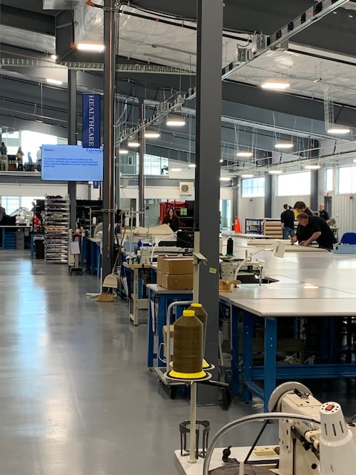
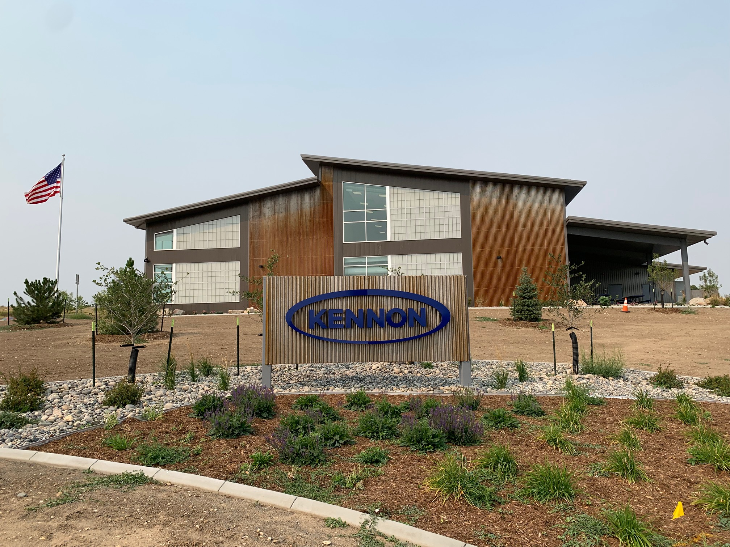
Existing Business
Notes:
Kennon Products was started in a garage in California in 1984, sewing airplane covers. The owner, Ron Kensey, relocated to Sheridan in 1989, working in his garage, small shop, eventually moving into an 11,000 sq ft old steakhouse building on Sheridan's North Main Street. Now, Kennon is known as a leading aerospace manufacturer and developer of aircraft protective coverings and other high-value assets.
Kennon Products partnered with the Sheridan Education and Economic Development Authority to expand. SEEDA secured grant funding from the Wyoming Business Council and the US Economic Development Administration to build a new 35,000 sq ft manufacturing facility in Sheridan's Hi-Tech Business Park. The facility is leased to Kennon Products and the company relocated to the new facility in June 2021.

Slide 19
Entrepreneurship: Living Your Dream
Notes:
Local Entrepreneur
What would America be without entrepreneurs? Our entire economic system has been built on the backs of people who dreamed of a better way, and then made it happen!
An economic development program provides a gateway for entrepreneurs to learn about the many resources available to start their businesses. Whether the product or service has a local or global market, the key is the circulation of dollars within the community.
Wyoming is filled with examples of individuals who took an idea and with hard work, patience and a dose of stick-to-itiveness were able to develop great companies. These companies thrive on the quality lifestyle, infrastructure and business friendly nature of the State of Wyoming.
The local hands on assistance provided by WEDA Members across the state link these business people to the programs and services which are needed to grow Wyoming.

Slide 20
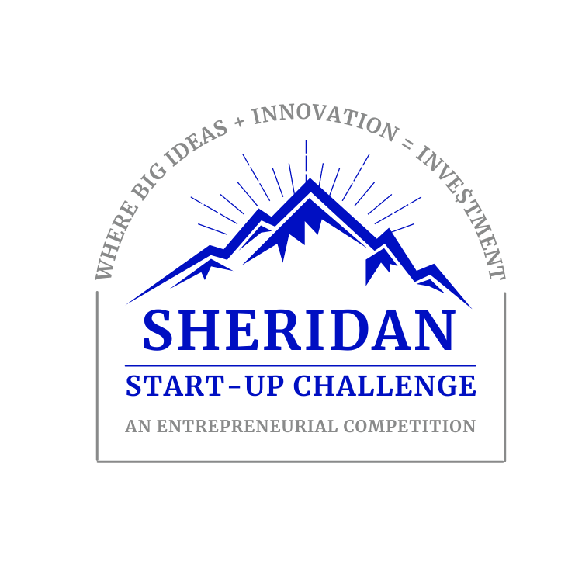
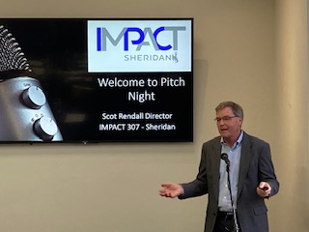
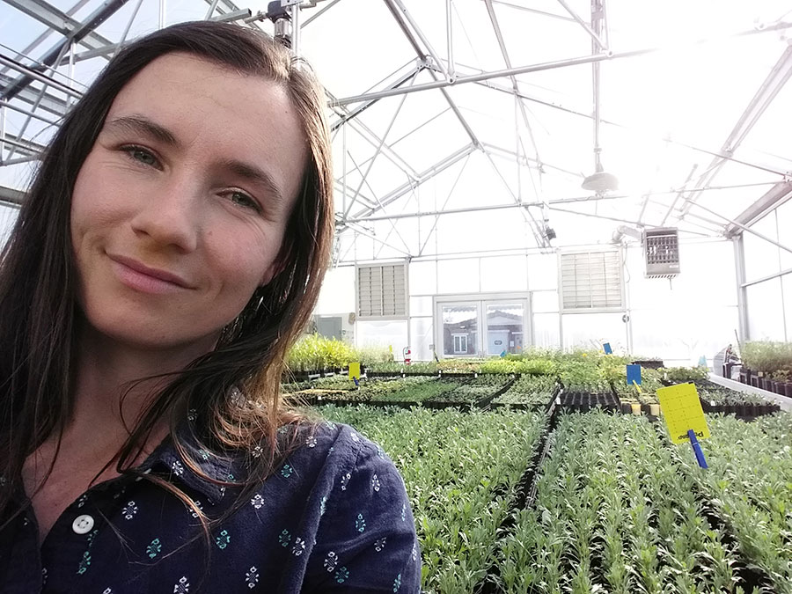
Home-Grown Companies
Notes:
One of the things that has been shown to help increase the number and success of entrepreneurs in a community or area is the enhancement of the Economic Development Ecosystem. This includes education, spaces that lead to innovation and shared ideas, access to mentoring and support, access to capital and a focus on helping support the risk.
Impact 307 is based out of the University of Wyoming, but is working statewide to help grow that entreprenerials ecosystem. One of the ways they are doing that is through Start-up challenges in various communities across the state. This model provides education and support for potential businesses or entrepreneurial businesses and then helps them pitch their business to potential investors in a competition that then awards dollars and more support to the best ideas. As you can see there is a start-up challenge in Sheridan, Casper, Southeast Wyoming, Laramie and growing rapidly around the state.
Impact 307 was recently awarded and EDA grant to help expand entrepreneurial opportunities across the state.

Slide 21
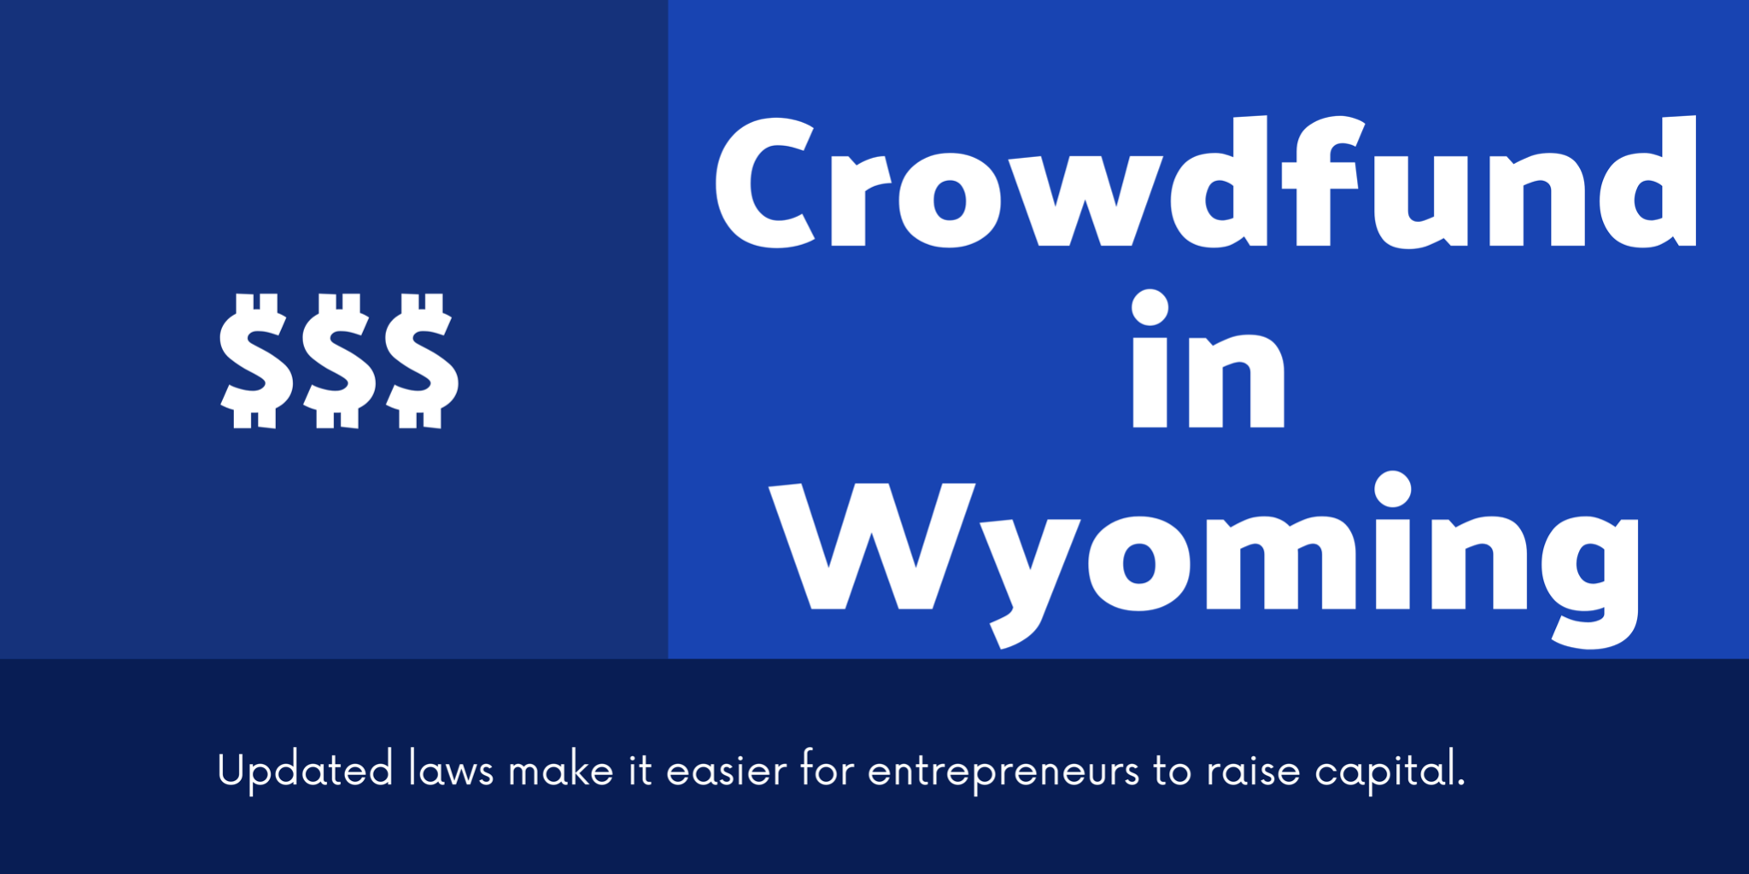
Entrepreneur Development
Notes:
Access to capital is always one of the biggest challenges for Entrepreneurs and in Wyoming that has been particularly difficult as Wyoming frequently rates as the hardest place for businesses to access to capital in the US.
However, there are a few growing initiatives that are giving entrepreneurs new options and communities can help as well.
Breakthrough 307 is Wyoming’s only organized angel investment group that provides early-stage seed capital to high-growth potential companies in Wyoming and the Rocky Mountain West. They are small, but growing and truly understand the timelines and needs of entrepreneurs.
Wyoming also recently created the opportunity for entrepreneurs to effectively raise money through crowdfunding. Legislation in 2021 that allow for more money to be raised and still be exempt from securities registration requirements in an offer or sale of a security by the user. It also removed reporting requirements that make it much easier for small entrepreneurs to access this opportunity. The Wyoming Secretary of States office has more information

Slide 22
New Business: Hitting the Target
Notes:
New Businesses
Relocating new businesses is the big splash in economic development. It’s what everyone wants to see in the headlines. It’s what many people have come to expect. But as stated, it’s part of a successful program, not the whole program. Positioned at the top of the pyramid also implies that it takes successes at all levels before it works and that is true as well.
If the total economic development program is solid at all levels, your ability to successfully attract new business will be greatly enhanced.
Good recruitment programs take time and are the result of great planning and even better positioning.
As you can readily see, the building blocks are connected. Each successive level requires the strength and stability of the lower level. However, as new companies come to town, the demands on infrastructure, housing and services changes, forcing communities to revisit these levels frequently.
Every Wyoming town has a story to tell about the passing stranger who fell in love with their community and returned to live. Our goal in economic development is to make our communities appealing to this type of outside investment and seek opportunities to grow our communities through recruitment (an example of how the building blocks are intertwined – quality of life with recruitment)
Additionally, our state graduates and sends forth many high school and college graduates into the world of business. How many of these natives could be attracted back home, with their company? The state’s business and tax friendly climate can be used to our advantage in recruiting new business.
Wyoming Grown Program
The tools afforded local communities through the Wyoming Business Council, in particular the Business Committed Program have enabled the relocation of key companies, such as XXXXXXXXX.
Update companies and pictures***

Slide 23
Business Recruitment
Notes:
Business Recruitment is what most of us think about when we think about Economic Development. It’s the sexy part of the development. It is very visible and can bring a great deal of impact. However, it is important that, like Ed said, that recruitment is very targeted, fits within the community’s plan and vision, and does not require assets that the community cannot provide.
Laser focused recruitment means that you truly know what your community can provide. If you have limited access to interstates, trying to recruit a distribution warehouse is probably not the best option. If you don’t have access to huge amounts of electricity, bitcoin mining may not work. The community needs to spend time really looking at what will work in your community and then focus on those businesses.
Avalon Project in Evanston –
Avalon manufactures aluminum products, specializing in door and window frames and other specialty fixtures. The company is moving into manufacturing doors and windows
Other products in the line include HVAC UV light systems for viruses.
WHY EVANSTON?
Rick and Baron are familiar with the area and were attracted to Wyoming because of the business-friendly climate. The area also offers supply chain advantages due to better logistics and location to raw materials available in Utah. They have outgrown their current, leased space and owning their own building was an appeal, not to mention the local culture and workforce ethics.

Slide 24
Business Recruitment
Notes:
Business Recruitment is what most of us think about when we think about Economic Development. It’s the sexy part of the development. It is very visible and can bring a great deal of impact. However, it is important that, like Ed said, that recruitment is very targeted, fits within the community’s plan and vision, and does not require assets that the community cannot provide.
Laser focused recruitment means that you truly know what your community can provide. If you have limited access to interstates, trying to recruit a distribution warehouse is probably not the best option. If you don’t have access to huge amounts of electricity, bitcoin mining may not work. The community needs to spend time really looking at what will work in your community and then focus on those businesses.
Avalon Project in Evanston –
Avalon manufactures aluminum products, specializing in door and window frames and other specialty fixtures. The company is moving into manufacturing doors and windows
Other products in the line include HVAC UV light systems for viruses.
WHY EVANSTON?
Rick and Baron are familiar with the area and were attracted to Wyoming because of the business-friendly climate. The area also offers supply chain advantages due to better logistics and location to raw materials available in Utah. They have outgrown their current, leased space and owning their own building was an appeal, not to mention the local culture and workforce ethics.
Data:
60,000 square foot building
Site development (parking, landscaping, etc)
An additional business will now relocate to Evanston due to the water and sewer infrastructure that will be in place as a result of the Avalon project. The lot has already been sold.
Area unemployment positively affected (6.3% in April 2021)
$5,000 to $15,000 per year in local sales tax estimated
$56,000 per year in state sales tax estimated
$25,000 to $30,000 per year in property taxes
Wyoming will be Avalon’s home versus Mississippi which offered $1 million cash relocation incentive
Job Creation:
17 jobs initially, most positions hired from the community
20 jobs by 2021
60 jobs by 2025, anticipated sales of $11.7 million
Wages/Benefits:
Average $34.50/hour base wage (roughly 140% of county median wage)
Anticipate providing benefits equivalent to $3-4/hour per employee
BRC grant will be recouped in 3.19years in economic impact
BRC loan w/interest will be repaid to BRC ($1,223,495) plus $750K(25% of grant) will be recaptured
Evanston Contributions:
Land valued at $130,000
Infrastructure valued at$500,000
Avalon Contributions: (A local bank assisted with some of the company’s contributions.)
$775,000 for equipment costs
$260,000 for moving expenses
$40,000 for engineering costs
$150,000-$250,000 for building materials
$500,000 cash match

Slide 25
What Can You Do?
Vision and Planning – Does your Community and/or Region have a Vision for what it wants to be? Does it have a plan with prioritized projects to get there?
Do you know what your community’s assets are? How are you telling people about these assets?
What partnerships do you have in place? How effective and committed is that partnership?
Do you have a plan for building your workforce or do you know what the local workforce development plan is?
How will you help your community succeed?

Slide 26
Economic Development is a process, not an event
Notes:
Process, Not an Event
As it should be apparent by now, economic development is much, much more that laying out a few carrots for a new company and wooing them to town. It’s a carefully thought out and executed strategy with a specific vision and goal in mind. It begins with local citizens and ends with them as well.
What is our problem?
How will we benefit from solving the problem?
What can I (we) do to make it happen?
These questions, constantly posed in a public forum, will help to grow a dynamic and successful effort in the community.
WEDA works hard to be a partner making the tools provided by the legislature become effective projects in their community. It’s a team effort!
Let’s add contact info

Slide 27
Thank you.
307-772-9001 wyomingeda.org info@wyomingeda.org

