Slide 1
Understanding the Building Blocks of Economic Development
Month Da, 2017

Slide 2
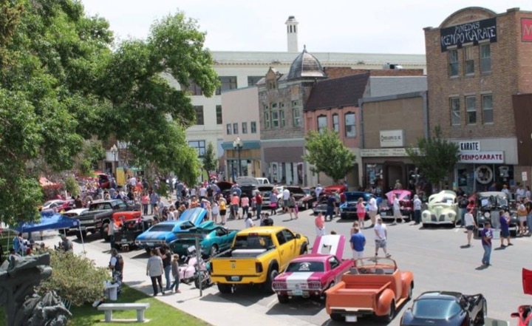
What is Economic Development? A lot more than you think!

Slide 3
Building Blocks of Economic Development
Notes:
Building Blocks
We like to think of economic development as “Building Blocks”. Each block in the foundation supports subsequent blocks. Obviously, the more stable the base, the more stable the economic development program.
As you scan the block titles, you can readily see that economic development is much more than financing businesses … it’s building a community to support and grow business.

Slide 4
Cycles of Development
Notes:
Cycles of Development
These building blocks can also be seen as cycles of development
The bottom 4 blocks provide foundation for the three above it;
And the 3 top blocks provide the funds for investing in the bottom 4

Slide 5
Leadership & Public Policy: A Strong Foundation
Notes:
Leadership Slide
All economic development starts with the desire of local people to improve their economic conditions. The dissatisfaction with “the way things are” becomes the catalyst for communities to face their problems. A basic premise to all economic development work is that when people agree on the problem, and see that they can benefit from solving the problem, it is easy to gain their support and investment toward a solution.
Local leadership and the implementation of supporting policy is the core building block of economic development. It is upon this foundation that a strong program can be built.
Do we want to add info on WEDA’s 2017 Strategic Direction?

Slide 6
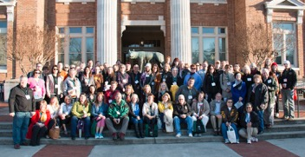
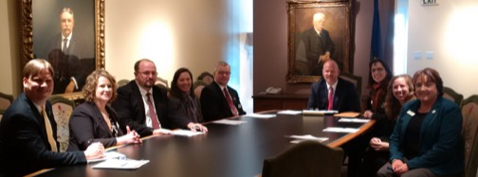
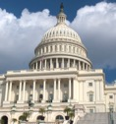
Without Leadership, Nothing Else Matters
Notes:
Without Leadership, Nothing Else Matters
True leadership and the development of public policy begins at the local level. This means providing opportunities for elected leaders and those leading civic organizations the opportunity to learn and gain experience in leadership. It also requires leaders to gain a deeper understanding of community and economic development.
Leadership in economic development starts at the local level in our town halls and commissioner board rooms. It’s those local leaders who provide the support and approval for project work.
On the state level, we require the support for programs and serves provide the core tools which allow our projects to be successful. The same is true for federal programs which may also be a player.
As we currently see in Wyoming, our state and federal leadership honed their skills locally as members of city government and of local civic groups before taking their skills to a larger arena. It is that understanding of the local need that helps them succeed in the development of state and federal policy.
WEDA members work to keep their local elected official up to speed on economic development activities. WEDA works on a statewide level to provide information which help to shape the policies and programs which empower our communities.

Slide 7
Leadership & Public Policy Development
Add examples of your local leadership and policy development initiatives here

Slide 8
Without Leadership, Nothing Else Matters
Custom photos here

Slide 9
Quality of Life: Work Where You Want to Live
Notes:
Quality of Life
One of the greatest success measures of community is the quality of life it affords it’s citizens. Because the people of every community are different, the quality of life is different as well. How we design our vision, goals and policy in a community directly impact the quality of life component.
Obviously, our natural environment also helps shape the quality of life as well. Savvy communities tie their community and its area attractions together to differentiate themselves from others. In Wyoming, we can easily say, Why live where you work? Why not work where you want to live?”
Wyoming communities are blessed with excellent public facilities. You have to travel pretty far to see the consistent quality of schools, hospitals, libraries, parks and local government offices. It is these quality investments that make Wyoming unique.
Add to that the amazing diversity of outdoor recreation. Whether you hunt or fish, hike or climb, you’ll find your niche here.

Slide 10
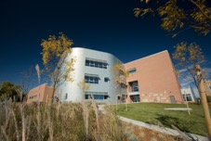
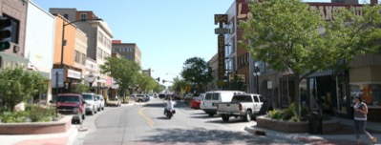
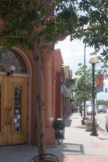
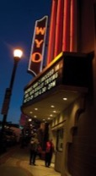
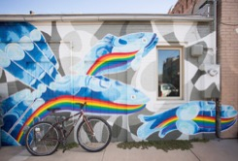
Quality of Life: Makes a Community Worth Living In
Notes:
WEDA Slide or Local Slide
Wyoming Economic Development Association (WEDA) provides leadership and support to foster economic development in Wyoming.
We do that via:
Mentorship Program
Legislative Committee
Conferences
Monthly Prosperity Call with WBC
Presentations/Outreach

Slide 11
Quality of Life
Talk about your local quality of life projects or features here

Slide 12
Quality of Life: Makes a Community Worth Living In
Custom photos here

Slide 13
Workforce: Without Good Employees, Job Creation is Not Possible
Notes:
Workforce
The driving force behind our economy is the quality of our workforce and its ability to turn a profit for their companies. Workforce is a direct result of education and ethic; having the basic knowledge of how to do a task coupled with the willingness to see it through.
Our communities are built upon the skills and capability of those who live in the community and the support these foundational principles.
A quality workforce is not only important to existing business, it is a key to success in recruiting new companies. A relocation expert indicates that 5 of the top ten factors used in site selection are criteria related to workforce.
A key tool for every economic development program in Wyoming is the Department of Workforce Service’s Workforce Development Training Fund.
These funds enable local companies to gain the needed skills and capabilities to grow and expand.
This program is used repeatedly by Wyoming citizens and businesses to improve their skill sets to become more attractive to relocating businesses requiring a trained workforce.
Should we include information on Workforce Development Council and local WAGs?

Slide 14
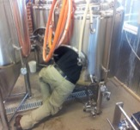
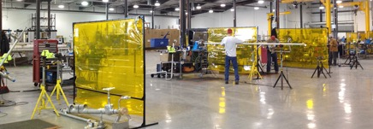
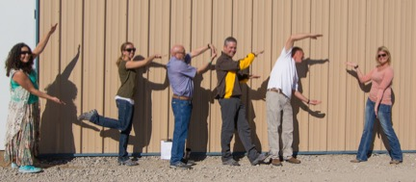
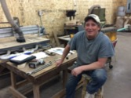
People, Skills and Work Ethic

Slide 15
People, Skills and Work Ethic
Describe aspects of workforce here

Slide 16
People, Skills and Work Ethic
Custom photos here

Slide 17
Infrastructure: “Shovel Ready”
Notes:
Infrastructure
The days of a vacant field being deemed an “industrial park” are over. Communities must be prepared to put forth property, ready to build in order to successfully recruit companies.
For economic developers, available space is market potential. It is our primary job creation tool. It’s what we have to “sell”!
A filled building or fully built out business park is USELESS for economic development.

Slide 18
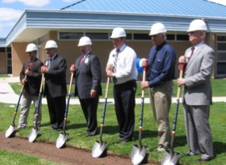
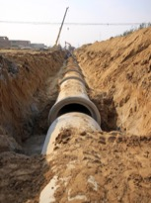
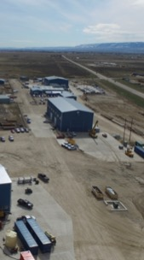
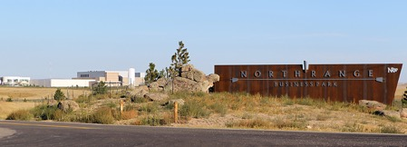
“Shovel Ready”
Notes:
Shovel-Ready
Economic developers used to believe that the raw land on the fringe of the community was “industrial”. That is no longer the case. Businesses seeking to expand need infrastructure including water, sewer, power, natural gas and telecommunications. Communities that are “shovel ready” are really ready for good economic development.

Slide 19
“Shovel Ready”
Describe your local projects here

Slide 20
“Shovel Ready”
Custom photos here

Slide 21
Existing Business: Grow Your Own
Notes:
Existing Businesses
Often referred to as “Business Retention and Expansion (BRE)” Programs
While it is tempting for economic developers to focus on the new and exciting relocation leads, the nuts and bolts of economic development reside in the businesses we already have. Many try to focus on the “big splashes” in our economy. As you see in the stats, 50 – 80% of job creation is within the existing core businesses in your community.
It makes sense as well. Each new job you create in an existing business, doesn’t require more public infrastructure, more traffic or more housing. Typically, this job growth draws employees from within the current job pool, helping employees to improve their earnings and enhance their lives.
Every community has its share of businesses which serve as the economic drivers of the community. As these businesses grow and expand, a ripple of economic benefit is felt throughout the community. Smart communities look at their core industry, analyze the best ways to grow upon their strength.
These same communities will also seek ways to diversify their economy in order to smooth out seasonal variations.

Slide 22
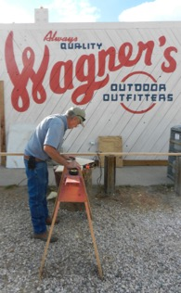
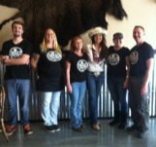
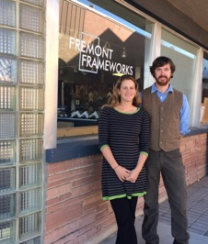
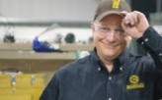
Vibrant Local Business

Slide 23
Existing Business
Talk about your local business development success stories here
Add testimonials from local business

Slide 24
Vibrant Local Business
Custom photos here

Slide 25
Entrepreneurship: Living Your Dream
Notes:
Local Entrepreneur
What would America be without entrepreneurs? Our entire economic system has been built on the backs of people who dreamed of a better way, and then made it happen!
An economic development program provides a gateway for entrepreneurs to learn about the many resources available to start their businesses. Whether the product or service has a local or global market, the key is the circulation of dollars within the community.
Wyoming is filled with examples of individuals who took an idea and with hard work, patience and a dose of stick-to-itiveness were able to develop great companies. These companies thrive on the quality lifestyle, infrastructure and business friendly nature of the State of Wyoming.
The local hands on assistance provided by WEDA Members across the state link these business people to the programs and services which are needed to grow Wyoming.

Slide 26
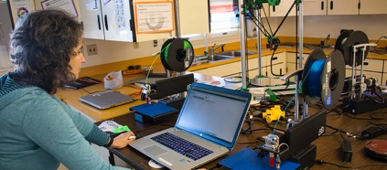
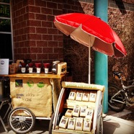
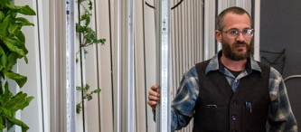
Home-Grown Companies

Slide 27
Entrepreneur Development
Describe your local start-ups here
Talk about the programs you use to help the start-ups

Slide 28
Home-Grown Companies
Custom photos here

Slide 29
New Business: Hitting the Target
Notes:
New Businesses
Relocating new businesses is the big splash in economic development. It’s what everyone wants to see in the headlines. It’s what many people have come to expect. But as stated, it’s part of a successful program, not the whole program. Positioned at the top of the pyramid also implies that it takes successes at all levels before it works and that is true as well.
If the total economic development program is solid at all levels, your ability to successfully attract new business will be greatly enhanced.
Good recruitment programs take time and are the result of great planning and even better positioning.
As you can readily see, the building blocks are connected. Each successive level requires the strength and stability of the lower level. However, as new companies come to town, the demands on infrastructure, housing and services changes, forcing communities to revisit these levels frequently.
Every Wyoming town has a story to tell about the passing stranger who fell in love with their community and returned to live. Our goal in economic development is to make our communities appealing to this type of outside investment and seek opportunities to grow our communities through recruitment (an example of how the building blocks are intertwined – quality of life with recruitment)
Additionally, our state graduates and sends forth many high school and college graduates into the world of business. How many of these natives could be attracted back home, with their company? The state’s business and tax friendly climate can be used to our advantage in recruiting new business.
Wyoming Grown Program
The tools afforded local communities through the Wyoming Business Council, in particular the Business Committed Program have enabled the relocation of key companies, such as XXXXXXXXX.
Update companies and pictures***

Slide 30
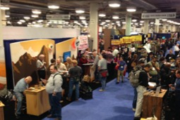
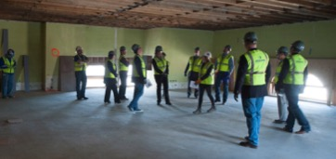
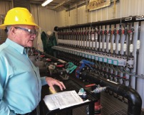
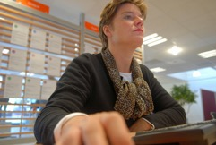
Business Recruiting: Adds jobs, Diversifies & Enhances Existing Base

Slide 31
Business Recruitment
Brag about your recruitment successes here
If it’s been a while since you’re recruited a new business to town, talk about what you’re currently doing to recruit business

Slide 32
Business Recruiting: Adds jobs, Diversifies & Enhances Existing Base
Custom photos here

Slide 33
Wyoming Business Resource Network

Slide 34
Economic Development is a process, not an event
Notes:
Process, Not an Event
As it should be apparent by now, economic development is much, much more that laying out a few carrots for a new company and wooing them to town. It’s a carefully thought out and executed strategy with a specific vision and goal in mind. It begins with local citizens and ends with them as well.
What is our problem?
How will we benefit from solving the problem?
What can I (we) do to make it happen?
These questions, constantly posed in a public forum, will help to grow a dynamic and successful effort in the community.
WEDA works hard to be a partner making the tools provided by the legislature become effective projects in their community. It’s a team effort!
Let’s add contact info

Slide 35
Thank you.
307-772-9001 wyomingeda.org info@wyomingeda.org

