Slide 1
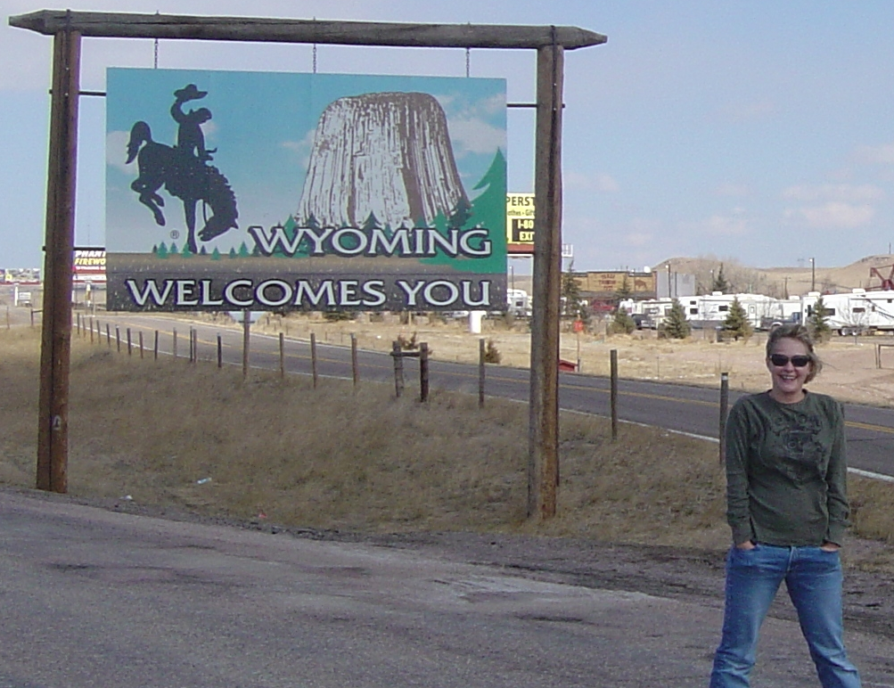
Prepared by:
Joe Sharkey
February 2016
Primary
Infrastructure Considerations
For Site Selection
Power
Broadband / Fiber
Water & Waste Water

Slide 2
Today’s Presentation will be primarily focused on 3 areas of Infrastructure
Power - Broadband & Fiber - Water & Waste Water
Related to Site Selection by New Businesses
BUT
There are many considerations or issues that are part of the site selection process including Infrastructure, Environment & Local Conditions
The type of business will dictate which issues are of primary concern
Internal politics of the company could/will substantially impact selection criteria
Federal, State & Local politics can impact the selection
There are many different scenarios but, in general, if we have situational awareness of the most common infrastructure points we
stand a better chance to be selected.

Slide 3
Sample Selection Points

Slide 4
Selection Points

Slide 5
Selection Points

Slide 6
Selection Points

Slide 7
Selection Points

Slide 8
Selection Points

Slide 9
Selection Points beyond our ability to mitigate
Proximity to Corporate Office
  Home for most current workers
  Travel to new location
  Moving time and costs
Proximity to customer base or brick & mortar locations
Proximity to Railroad Lines and/or Major Highways - Airports
  2 edged sword mostly for data centers
    Good for getting employees to/from work
    Not good if visible from Highway
    Not good if within XXX distance of rail line or highway (transportation of explosives-toxins-chemicals)
  Good for many other industries/companies
Snow Issues
Political Issues
  Too conservative??
  Guns
  In Utah – belief that you can’t buy a drink in the State
Population & Cultural Issues
  Large Call Centers need large population (35%+ annual turnover)
Incentives from other States

Slide 10
Points I have had to deal with in the past
Must be in a Class A Building in a Major City
Must be 1 airline segment away & within 1 hour of that airport
  Not good if the home location is not a major airline hub
Must have at least 2 or 3 Golf Courses
Must have high end restaurants
  (like Morton’s, Del Frisco’s, Sullivan’s, Smith & Wollensky’s, etc.)
Must be in a Major University City
Must have professional sports team(s)
Must be in a beach city
Must have a Ritz-Carlton Hotel
Must have “good” Gentlemen’s Clubs
Not in CA, MA or on a Native American Reservation
One customer’s VPs wanted all the green items

Slide 11
Mythbuster Observation
MYTH
All Site Selectors are well versed in the company’s facility needs and are primary influencers in the final site selection!
BUSTED
Many Site Selectors have technical and/or operational backgrounds too many have little or no such background and often do not even know much about the actual needs of a new facility other than size of property and building.
Some are contractors that specialize in the process but know little about the actual facility functions and primary needs.
Some have technical, operational and good company insights as well as are part of the facility design – so they are usually the best for understanding the real needs of the prospect.

Slide 12
Some issues successfully dealt with in WY.
In the last couple years in Wyoming we have seen several “issues” that have arisen where a clear understanding of infrastructure, environment or local ambient issues needed to be addressed in a positive manner:
Power –
  Available actual capacity vs current contracted capacity
    At Distribution Level & At Transmission Level
  projected costs in an equal comparison – (example to follow)
    Worst case projection vs Best possible case projection
      With or without projected local or state incentives
Fiber / Broadband
  My carrier does not have presence in Wyoming
Water & Waste Water– capacity, availability & cost
  for cooling
  for fire suppression
Altitude
  Climate cooling
  Thin Air
Population – too low in immediate are
  Wyoming – 1+ hour drive time is common so larger base for draw

Slide 13
Primary Drivers for Site Selection
The primary drivers for site selection today are aligned with what Wyoming has to offer in numerous communities:
  Locations with population of 50,000 or smaller but with access to technology resources – people.
  Power
    Price of Power – usually at “Transmission Level” if over 8 MW load
    Loop or ring power supply available or
    Multiple sources available
    Dual path feeds – from separate substations
    Ability to meet initial and long term load requirements with minimal up charges
    Quick construction time
  Multiple Communications Options
    Broadband Services from multiple and diverse service providers usually via
    Fiber Optic Cable
    Dual Path
    Possibly multiple providers with dual path
    Diverse paths
    Regional or National Ring Network access
  Water
    Potable – drinking, cleaning and typical office type use
    Cooling water supply – doesn’t need to be Potable
    Fire Suppression Systems
  Natural Gas
    Office space/personnel heating
    Fuel for Backup power – Generators
  Cool Ambient Air
    Free Air Cooling Strategy to reduce power and water consumption
  Shovel Ready for Development
    Available spaces with minimal restrictions such as: zoning, permitting, building size/type, ecological, archaeological, wetlands, water rights – and no anti-development/neighborhood action committee issues.
Diesel fuel for Generators –if over 40,000 gallons comes under FEMA control.

Slide 14
If initial contact or visit by site selector(s) is not detailed or if they don’t have sufficient understanding of all the company’s requirements it could lead to being selected and then having the site be abandoned due to infrastructure issues.
Sometimes the site selection is done without disclosing the actual prospect (I have done several this way). Sometimes the question and answer process will be limited so the type of business or name of prospect will not be revealed. Although this happens often it leave the door open for poor site selection or diverting substantial resources on wild goose chases.
The more knowledge of overall needs are understood by the economic/business development personnel the better you may be to qualify a prospect or draw out a better picture of the actual needs. The more you know the better you will be equipped to determine if your community is a good match.
Sometimes other communities or State’s personnel may take a run at developing competitive data by posing as a site selector. This often is apparent from lack of any specificity from the site selector.

Slide 15
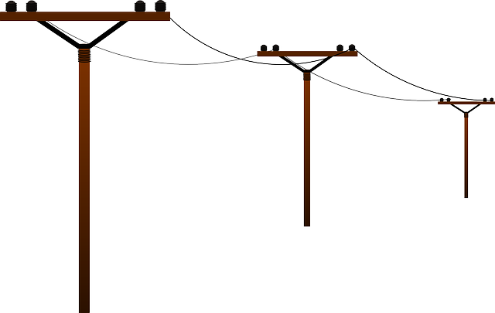
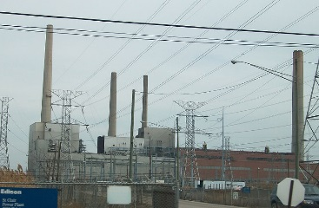


Power Systems & Costs Overview
Power Distribution Lines
Typical Coal Powered Generation Plant
Power Transmission Lines
Typical Wind Powered Generation “Farm”

Slide 16
WAPA (Western Area Power Authority)

Slide 18
Rocky Mountain Power Transmission Lines
Wyoming produces 6,970 mW of power
90+ % of Power Produced in Wyoming
Is sold outside of Wyoming

Slide 19
Why is it so difficult to determine Available Capacity
Wyoming & Surrounding area are “controlled” by WAPA
  Western Area Power Authority – Federal Gov’t Agency
Generators, Transmission lines & Substation are not owned by WAPA but by numerous owners/operators
  Power Generation, Transmission and Committed are “managed” by WAPA
  Any new demand over 5 or 10mW can require a power company and WAPA engineering Study to be performed
The Power Grid has regional, statewide & local rings/loops as well as unprotected lateral lines – Ring/Loop design allows automatic recovery when lines are damaged or fail
Grid is designed to allow any 1 or 2 local Generating sources to be off line and still maintain the committed/demand
A local grid is usually part of a larger grid and commitment in one area can reduce the available capacity across that whole grid or even the region or state
  When Microsoft took 30mW in Cheyenne it reduced available “uncommitted” capacity in Laramie, Casper & into Colorado
  Power sold outside the state is a commitment that will reduce the uncommitted capacity locally
Local operators often don’t think outside the box or stay cognizant of changes in the grid
Studies can take 3 to 6 months and cost upwards of $25,000 & need to be reviewed often
Extending Transmission or Distribution lines can take years of planning, approvals & ROI

Slide 20
Components of the Power Grid

Slide 21
Components of the Commercial Power
Transmission Lines are usually:
  69kV, 115kV, 138kV, 230kV, 345kV, 500kV & 500kV DC
Distribution Lines are usually:
  =< 34.5kV
Capacity in a line at any time is determined by:
  Available Capacity
  Utilization “Load”
  Committed “Demand”
Under-utilization is generally not part of typical study

Slide 22
Components of the Commercial Power
There are many different power companies in the state and each has their own specific rate structures that are registered (Tariffed) with the state regulatory commission.
There are a few to many different rate plans within each company.
There are transmission level power rate plans but usually a company would have to have a very large load (10 mW +) and they would have to install and maintain a private network compatible transformer.

Slide 23
Components of the Commercial Power Cost
Example 800kW demand & 95% Utilization
Transmission level power rates normally do not include cost for expensive transformers to convert 69, 115, 138, 230 or 345kVA to normal industrial voltages – this can be a huge CapEx cost.
Some companies have a NO Demand rate but 100% of all consumption must be between 11pm and 6:59am
Not 1 minute sooner or later!

Slide 24
Components of the Commercial Power Cost
Example 800kW demand at 95%
The below rates are not representative of any Wyoming Power Company Published Rates
95% utilization would be very unusual

Slide 25
Components of the Commercial Power Cost
Example 800kW demand at 11.42%
The below rates are not representative of any Wyoming Power Company Published Rates
11.42% utilization would be very unusual
It would mean only using power 20 hours per week

Slide 26
Components of the Commercial Power Cost
Example 250kW demand at 95%
The below rates are not representative of any Wyoming Power Company Published Rates
95% utilization would be very unusual

Slide 27
Components of the Commercial Power Cost
Example 250kW demand at 11.42%
The below rates are not representative of any Wyoming Power Company Published Rates
11.42% utilization would be very unusual
It would mean only using power 20 hours per week

Slide 28
Components of the Commercial Power Cost
Example 250kW demand at 65%
The below rates are not representative of any Wyoming Power Company Published Rates
65% utilization would be reasonable
7 days/week at 16 hours/day

Slide 29
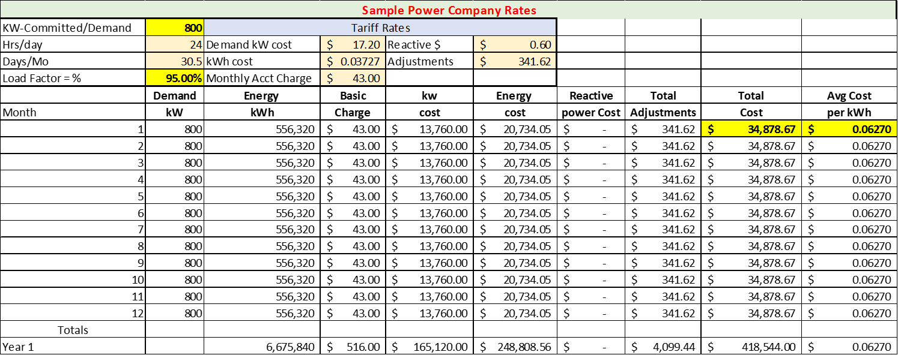
Components of the Commercial Power Cost
Example 800kW demand at 95% & 250kW damand at 11.4% Utilization

Slide 30
Components of the Commercial Power Cost
Take Away Understandings
kW - KiloWatt Commitment/Demand has a substantial impact on overall monthly cost
kWh – in this case 24hrs per day X 30.5 days per month = 732 possible hours of Committment/Demand
  732 X 800 = 585,600 or 732 X 250 = 183,000
  5 Days/Week for 10 hours/day = 210 hours/month = 28.68% of a billing time period
  7 Days/Week for 16 hours/day = 470 hours/month = 64.5% of a billing time period
Load Factor in % - estimated or actual amount of utilization compared to commitment
High kW Commitment/Demand with Low load factor substantially drives the kW $$ up
    Minimizing kW Commitment/Demand and having a high Load Factor drives the kW $$ down
kW Commitment/Demand will automatically increase (for long time) if kW surpasses the commitment/Demand for just 15 minutes in a billing period
kW Commitment/Demand will NOT automatically decrease (ever) if kW is below commitment/Demand in any month – even if always substantially below commitment
Reviewing kW with provider should be an annual or semi-annual event – if constantly under utilized reduce the kW in your contract
  Under committed kW at start-up is better cost wise than over committed
  Re-engineering load or work hours can sometimes reduce actual demand

Slide 31
Components of the Commercial Power Cost
Additional Considerations
kVAR - Reactive Power Charge
The maximum 15-minute reactive demand for the month in kVar in excess of 40% of the measured kW demand for the same month will be billed per kVar of such excess reactive demand. – could be $0.60 to $1 per kVAR
  Very High demand for short periods impact the network
  KVAR = kilo (thousands of) volts times amperes, reactive, which is a measure of the rate of energy that is sloshing back and forth, twice a cycle, between an AC source and a reactive (capacitive or inductive) load. The phase difference between the voltage wave and the current wave components used for this measure is + or - 90 degrees.
Demand
The kW as shown by or computed from the readings of Company's Demand meter for the 15-minute period of Customer's greatest use during the month. The Company
determines billing demands to the nearest whole kW.

Slide 32
Components of the Commercial Power Cost
Actual Case Manufacturing Company
3 – production systems - 300 kW to start up each -50 kW operating demand each
50 kW for all other electrical demand - 8 hour/day general workforce
1 hour pre-shift start up - 1 hour post-shift shut down
Traditional Operating Model
Start 3 systems in 1st Hour = 900 kW
Other demand = 50 kW
Total Commitment/Demand = 950 kW
Cost per kW (examples above) = $17.20
Monthly Commitment Cost = $16,340
Re-engineered Operating Model
Stagger system starts 1st = 300 kW = 300 kW
2nd = 300KW + 50 kW (1st) = 350 kW
3rd = 300kW + 100 kW ( 1 & 2) = 400 kW
Other demand = 50 kW
Total Commitment/Demand (47.4% of Traditional) = 450 kW
Cost per kW (examples above) = $17.20
Monthly Commitment Cost = $7,740
Power Cost Savings = $8,600 / Month or $103,200 / Annual

Slide 33
Example of underutilization Impact
On one project in Upstate New York we were looking for 25 mW of Demand
Grid had approximately 2,000 mW in the area
NY State had access to 20% of the 2,000 mW (400 mW) for $0 Demand cost to attract new business to the Upstate area
Power Company was fully committed for their 1,600 mW
Client was looking to get 25 mW of NY incentivized power at $0 for kW demand.
Existing Commitment/Demand for the incentivized load to be 395 mW
Power Company records showed over 40% of the 395 mW (158 mW) Commitment/Demand to be under utilized
Effects of underutilization
Power Company could not sell 158 mW of power
Power Company had to accommodate back up power generation for underutilized commitment/Demand
NY State could not offer incentives to 158 mw for new businesses
Client could not get power commitment so did not select site in this area

Slide 34
Partial Grid in Wyoming
240mW
Gen #5
City
96mW
City 1
Gen #6
95mW
340mW
City 3
Gen #7
Gen #8
City 2
Gen #11
Gen #10
95mW
30mW
15mW
Gen #9
City
City
Gen #12
City
City
15mW
City
Gen #2
238mW
Gen #4
16mW
Gen #3
City 4
99mW
Gen #1
830mW

Slide 35
City #1 Example of Power Situation
Transmission Line - 2,109 mW Capacity
Spare Capacity at
Substation = 100+mW
Transmission Line - 2,109 mW Capacity
Local Substation #2
10mW Contract
And Capacity
2mW uncommitted
City #1 – Disclosed Power Situation:
Local Power Co Contracted for 10mW
With 2 mW uncommitted
Data Center Looking for 10/20mW
Site Selector told only 2mw Available
Info should have been
100+ mW uncommitted capacity at Main Sub
Transmission line capacity Available
Power Co needs to increase contract
Power Co needs to add upgraded Transformer at Substation #2 = < 4 months
Local Transmission Lines
100+ mW Capacity
City #1
Transmission Line - 2,109 mW Capacity
Local Substation #1
10mW Contract
And Capacity
Transmission Line - 2,109 mW Capacity

Slide 36


Fiber and Broadband Overview

Slide 37
Fiber Or Broadband ?
Fiber
Generally the need for direct fiber or “dark fiber” is only required by large data centers, high tech companies, call centers and Federal Government facilities or Drug Co. with some exceptions
Usually if a prospect in Wyoming is looking for fiber they will want to connect to some hub location like Denver, Salt Lake City or Billings or a combination of these locations
Often a prospect is looking for a moderate amount of bandwidth (10mb, 50mb, 100mb, 1Gig) that they will use for internet and telecom services (local fiber ?)
Some larger prospects may have corporate agreements with a carrier (AT&T, Sprint, Verizon, Level3) and will want to connect to that carrier’s hub location(s) like Denver, Salt Lake City or Billings.
Usually that carrier can work out connectivity with CenturyLink, ACT, TCT, Charter, Silver Star, AllWest, Union Tel,etc
Broadband

Slide 38
Wy City Example of Corporate Carrier Situation
Prospect internal Politics
Company President wanted to locate to Wyoming city.
Company CTO said Wyoming will not allow connectivity to EU carrier so Wyoming is not acceptable
Wyoming Business Council & Local EDC work with outside assistance to identify solution
Solution:
CenturyLink, ACT, Bresnan/Charter Level3 can all meet the EU carrier in either Denver or Salt Lake City or both.
Interestingly that same EU carrier actually passed through the area in two (2) of the nearby I-80 routes but did not have interconnection points in Wyoming.

Slide 39
Why all the emphasis on fiber if broadband capacity seems so available ?
Fiber is the medium for delivery of most communication and increasingly cable company services.
  Most broadband services are aggregated at some local point and then transported over fiber to regional and/or national networks.
Other than along I-80 & I-25 Wyoming has some significant shortages of local access fibers.
Some fiber network owners do not contract for fiber leases or IRUs so large network operators may not be able to acquire the service they want (dark fiber) in some areas

Slide 40
Is the state of Wyoming doing anything to improve broadband access & fiber ?
Wyoming Department of Enterprise Technology Services has developed a Unified Network plan, gone to bid and has selected primary vendor(s) and is implementing a 100Gbps Statewide network.
  This is a brand new extremely high capacity network which can deliver 40 channels at 100Gig each (on a pair of fibers). This new equipment will accommodate significant broadband capacity all along the fiber routes provided by CenturyLink and ACT.
Governor Mead has pushed for changes in WYDOT that will open access in the interstate highways in WY for fiber construction in the ROWs
  This requires the permit applicant to construct facilities that must be sold or leased to competitors therefore opening the way for multiple service providers along new construction routes.

Slide 41
Unified Network
Kemmerer
Century Link has two distinct fiber routes
from Evanston to Cheyenne (not shown) between Denver and Salt Lake City
Evanston

Slide 42
Wyoming Unified Network Update
8 State Carrier Neutral Locations (Cities) - Unified Network Core sites:
9 - 100 gig backbone circuits (provider)
1. Cheyenne - Emerson Bldg, Cheyenne, WY
2. Casper - Casper Community College
3. Sheridan - Sheridan High School
4. Basin - Riverside High School
5. Riverton - Fremont County School District 25
6. Jackson - G&F District Office
7. Rock Springs - Sweetwater CSD#1 Admin
8. Laramie - UW
1. Cheyenne to Casper - CL
2. Casper to Sheridan - CL
3. Casper to Riverton - CL
4. Riverton to Jackson - CL
5. Jackson to Rock Springs - CL
6. Rock Springs to Laramie -CL
7. Laramie to Cheyenne - CL or Bison Ring
8. Riverton to Basin - ACT
9. Basin to Sheridan - ACT

Slide 43
Wyoming Unified Network Update cont.
Significant fiber gaps that have been installed across the state include:
  CL - Pinedale to Rock Springs
  Union - I-80 Wamsutter to Walcott Junction, Rawlins to Muddy Gap, to Lander.
  Union - I-80 Around Elk Mountain to Saratoga
  ACT - I-25 Casper to Cheyenne and to CO state border
Currently ETS is going through 340 circuits that went out for bids statewide and closed January 13th. These include school and state agency circuits, which will connect back into the backbone at core locations.
As an overview, we have many more providers competing, gigabit bandwidth and better pricing.
Add/drop and medium is currently under review with this process.
Central office equipment has been installed and upgraded by ISP's to be able to handle and offer gigabit connectivity to communities.
Last mile is still a site by site analysis, but the backbone has very much improved to handle high bandwidth.

Slide 44
TCT
Silver Star
Jeffrey
City
ACT Leased/IRU Fiber
Indefeasible Right of Use (IRU) is a contractual agreement, usually 20 years, between the operators of fiber optic network cables.
All West
Savery
Baggs

Slide 45
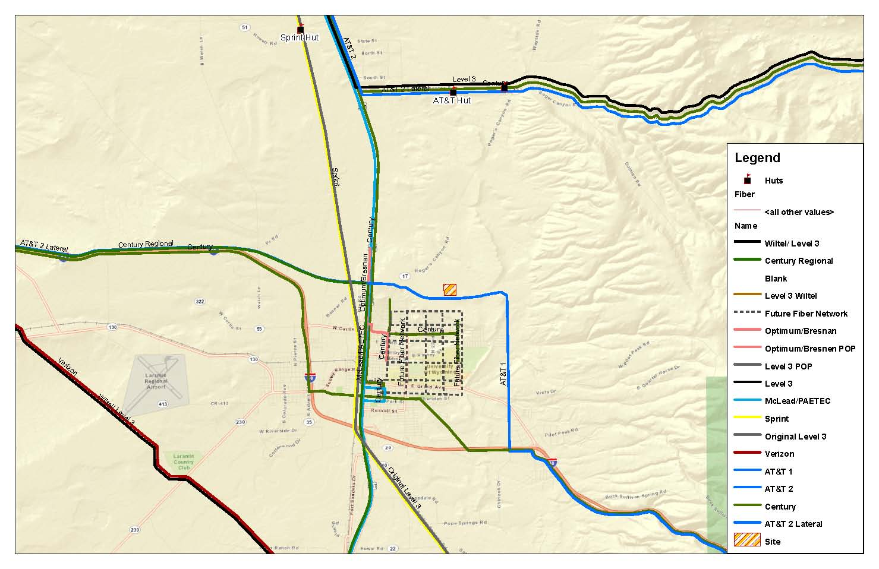
Example of Local Fiber Overview
Horse Creek
How Much Fiber Do We Have?
9 East/West Routes - 7 Trenches
1 Regional Routes
AT&T 2 & CenturyLink/Enron, Broadwing/Level3
Sprint & Orig Level3
AT&T 1 & CenturyLink
3 – Level3
Original L3
Broadwing
WilTel/Williams
2 - AT&T
1 w QW
1 w Broadwing
2 CenturyLink
1 w AT&T
1 old Enron
1 Sprint
1 VZB/MCI
1 McLeod/PaeTec
Verizon/MCI &
Wiltel/Level3
AT&T 1
McLeod/PaeTec &
CenturyLink Regional

Slide 46
Example of Local Hut/POP Locations
Sprint
CenturyLink
Enron
CenturyLink/Enron
AT&T 2
Boradwing/Level3
All at Horse Creek
AT&T 2
Broadwing/Level3
CenturyLink
& AT&T
Level3 Orig
Bresnan/Optimum
CenturyLink
4th Street
Wiltel/Level3
Herricks Rd-I80
VzB/MCI
46

Slide 47
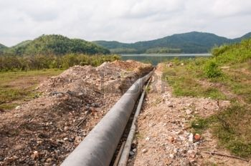
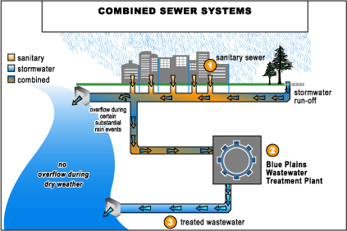
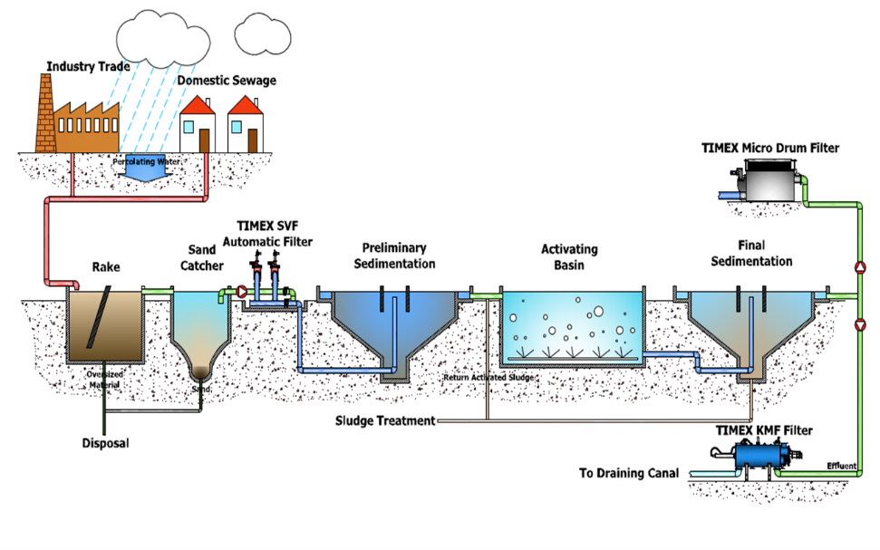
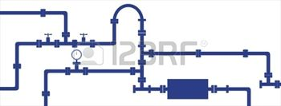
Water & Wastewater Considerations

Slide 48
Water Considerations
General Water Considerations
Drinking
Sinks
Toilets
Routine Cleaning
Showers (LEEDS Qualifying? )
LEED Certification (Leadership in Energy and Environmental Design) is a certification process aimed at rewarding sustainable and environmental friendly decisions that are part of your construction process.
Production/Operational Water Considerations
Food/beverage processing
Cleaning of production system(s)
Air Conditioning – chilled water
Heating – hot water Radiators
Large Steam Plant(s)
Cooling – production systems – like some data centers
Fire Suppression

Slide 49
General Water Considerations
In general water needs for drinking, Sinks, Toilets, routine cleaning and showers is determined using industry standards related to type of business, size of the build and estimated number of employees.
Some business types or LEED certification can impact the “standard” water consumption needs such as:
data center – lower needs per sq ft
call center – usually higher needs per sq ft
Warehouse - lower needs per sq ft
Transportation hub - lower needs per sq ft
Big Box Store - lower needs per sq ft
If a site is being considered outside of the current municipal water system any facility may require extending the water system.

Slide 50
Production/Operational Water Considerations
There are many water needs/demand issues related to production &/or operational systems depending upon the industry Type.
Municipal Water may be needed for Food/beverage processing and the Cleaning of production system(s). Some food production systems may need additional filtering but usually municipal water can be used. Standard Municipal water rates can be acceptable.
However larger facilities that may need to use water for Air Conditioning – chilled water, Heating – hot water Radiators, Large Steam Plant(s), Cooling – production systems – like some data centers and Fire Suppression may have design and operating cost issues with using municipal water primarily due to the cost of the water or the capacity of the supply system (pipes) in the area.
It may be beneficial to think about alternatives to the normal Municipal filter water supply if substantial water needs are required

Slide 51
Alternate water sources / supplies
For some large facilities there may be need for large volumes of water - sometimes for short durations or even, potentially, never but traditional planning looks at the cost of municipal water as well as the cost to construct an appropriate sized pipeline. Sometimes a municipal water system can not accommodate the demand or construction costs (extending and/or increasing pipe size(s).
Air Conditioning – chilled water
Heating – hot water Radiators
Large Steam Plant(s)
Raw water or unfiltered water can be used for such applications.
Closed systems should be designed to minimize lose.
Some open chilled water systems can recirculate to supply but at a few ° higher
Treated Wastewater output could be a possible source.

Slide 52
Alternate water sources / supplies
For some large facilities there may be need for large volumes of water - sometimes for short durations or even, potentially, never but traditional planning looks at the cost of municipal water as well as the cost to construct an appropriate sized pipeline. Sometimes a municipal water system can not accommodate the demand or construction costs.
Cooling – production systems – like some data centers
Fire Suppression
Raw water or unfiltered water can be used for such applications.
Fire suppression often drives flow requirements (gpm) and local pipe size
Storage tanks can minimize but:
  Wyoming weather can mandate heated or buried tanks
  Redundant pumps may be required
  Separate generator may be required

Slide 53
Alternate water sources / supplies
Work with local city & utility operators to:
  determine best locations for accessing alternate water
  best locations where wells might be best located
  determine if accessing raw water, like for a golf course, is available in the area
  determine where large supply lines are available

Slide 54
Wastewater Considerations
Work with local city & utility operators to:
  determine where wastewater output is delivered
    Volume – probably not enough to support a large fire suppression demand
    Temperature
    Ability to be piped to commercial site

Slide 55
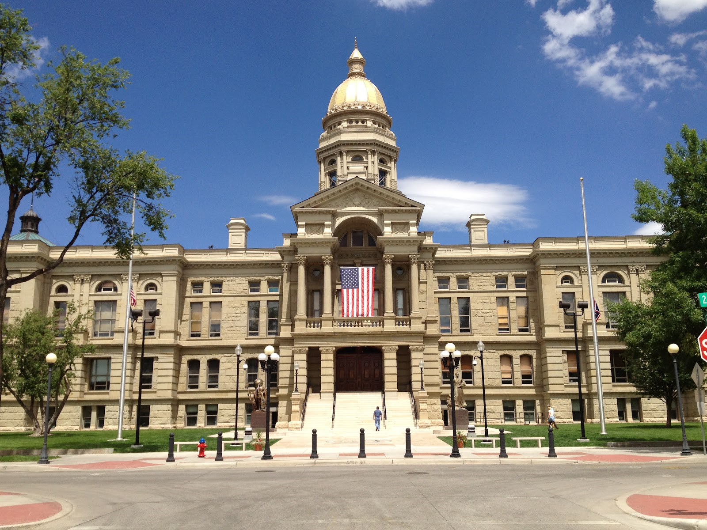
Fiber in Wyoming
Why So Much Fiber in Some Area
But So Little Access
Wyoming
Technology
Business
Center

Slide 56
Typical Long Haul Carrier Network Map
Wyoming is a
Pass Through
Typically Long Haul Fiber Routes Were Built With Wyoming As A Pass Through State while creating local, regional & national rings.
Local Wyoming Carriers were expected to meet the long haul networks at hub locations
Local Wyoming Carriers were Expected to “Tie in” at their expense.

Slide 57
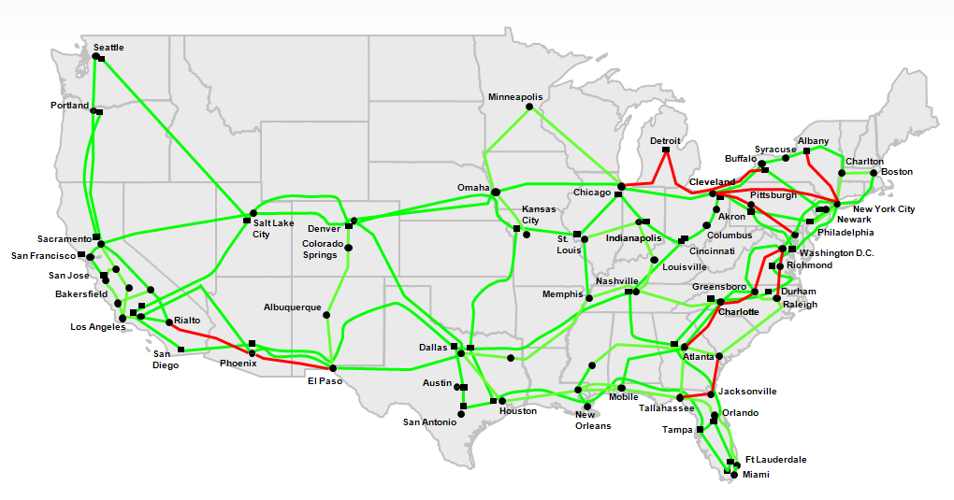
Typical Long Haul Carrier Network Map

Slide 58
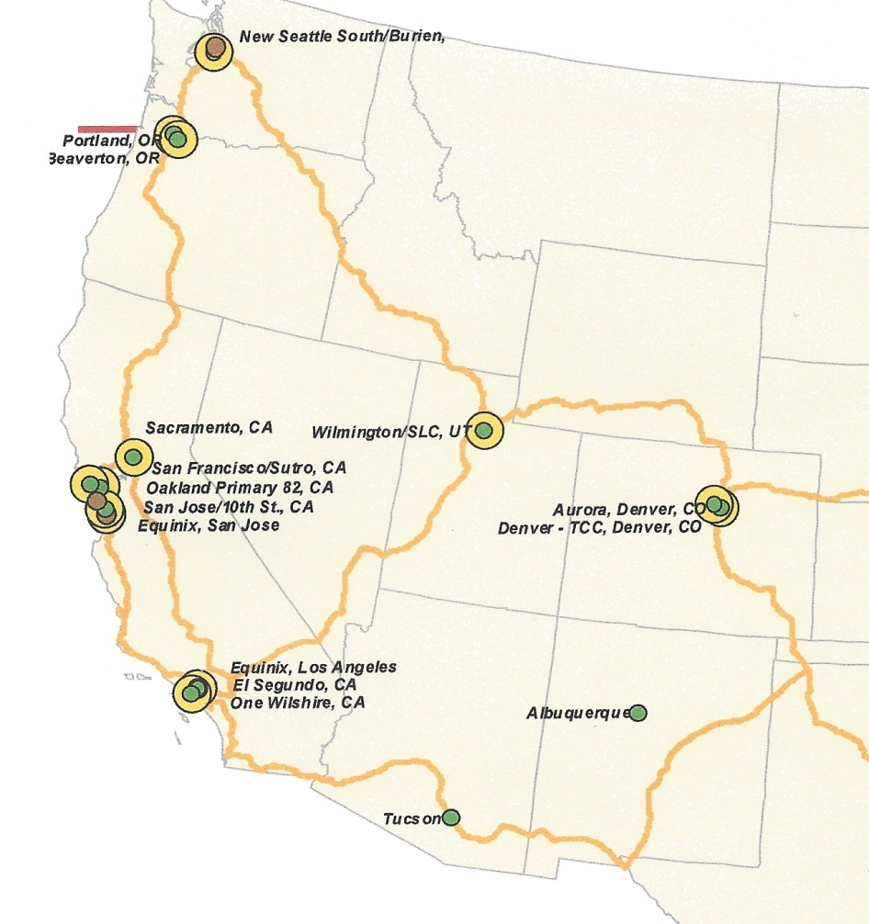
Why Rings ?
Potential
Alternate Routing
Site
Rings allow data to flow bi-directional simultaneously – any failure in one direction still allows uninterrupted flow in the other direction

Slide 59
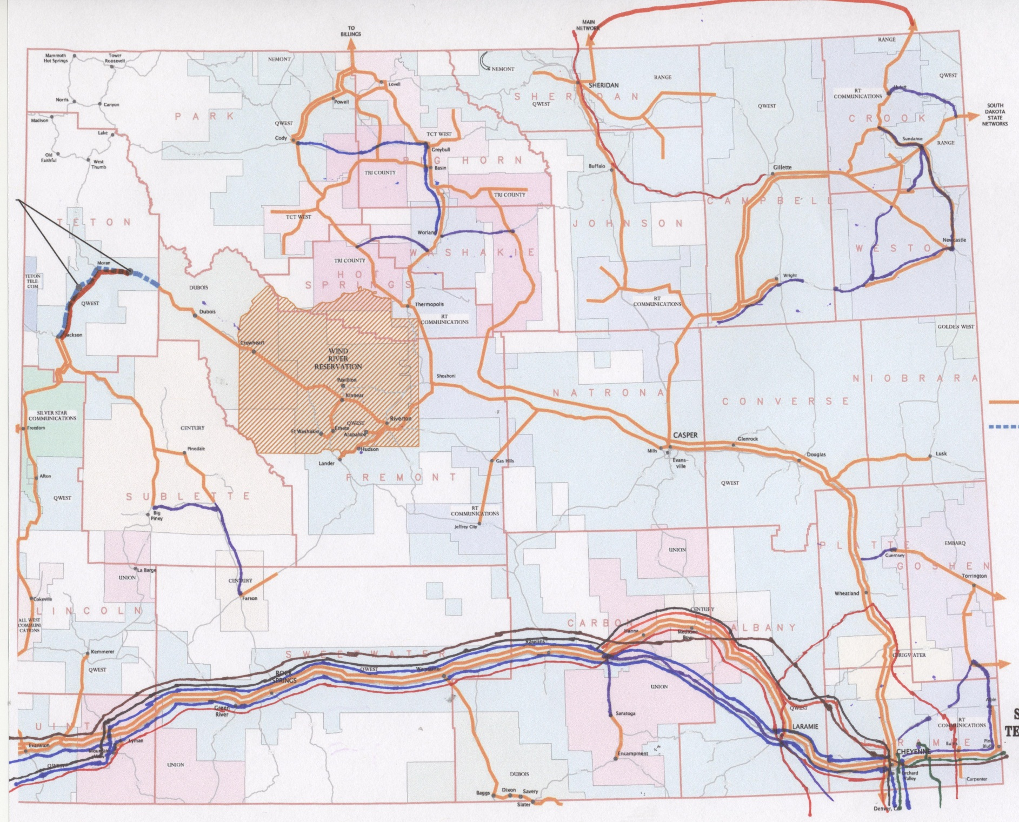
Wyoming State Wide Fiber Map

Slide 60
Example of how one city prepared fiber info
Horse Creek
How Much Fiber Do We Have?
9 East/West Routes - 7 Trenches
1 Regional Routes
AT&T 2 & CenturyLink/Enron, Broadwing/Level3
Sprint & Orig Level3
AT&T 1 & CenturyLink
Work with local city & utility operators to:
3 – Level3
Original L3
Broadwing
WilTel/Williams
2 - AT&T
1 w QW
1 w Broadwing
2 CenturyLink
1 w AT&T
1 old Enron
1 Sprint
1 VZB/MCI
1 McLeod/PaeTec
Verizon/MCI &
Wiltel/Level3
AT&T 1
McLeod/PaeTec &
CenturyLink Regional

Slide 61
Identified possible add/drop locations
Sprint
CenturyLink
Enron
CenturyLink/Enron
AT&T 2
Boradwing/Level3
All at Horse Creek
AT&T 2
Broadwing/Level3
CenturyLink
& AT&T
Level3 Orig
Bresnan/Optimum
CenturyLink
4th Street
Wiltel/Level3
Herricks Rd-I80
VzB/MCI
61

Slide 62
Optronics Options for “Lighting” Fiber
Single Wavelength
Course Wave Division Multiplexing - CWDM
Note – Colors are for emphasis purposes only
Actual “colors” are “shades” of a single color
Dense Wave Division Multiplexing
Note: Wavelengths are intercepted 4 at a time.

Slide 63
Example of a Carrier’s Services with Access to Fiber Route
Customer site
Customer site
Customer site
Customer site
T1
T1
T1
T3/
DS3
Primary Carrier
Primary Carrier
TDM-Optical Router
Existing T Splice
Existing T Splice
HUT
HUT
Existing Splice Points in Carrier’s or underlying owner’s Fiber Route

Slide 64
Example of a Carrier’s Services with Access to Fiber Route
Customer site
Customer site
Customer site
Customer site
T1
T1
T3/
DS3
T1
Local Carrier
Optical Router
Primary
Carrier
Carrier Local Fiber
HUT
HUT
L3 Existing Splice Points
HUT
HUT
Existing Splice Points

Slide 65
Local Carrier Fiber bypass primary carrier’s with Access to 3rd Party Fiber Route
Customer site
Customer site
Customer site
Customer site
Primary
Carrier
Local Carrier
Optical Router
Carrier Local Fiber
Single Wave = 2.5 gig
HUT
HUT
Level3 Existing Splice Points

Slide 66
Local Carrier Fiber bypass Primary Carrier with Access to 3rd Party Fiber Route at Huts
Customer site
Customer site
Customer site
Customer site
Primary
Carrier
Local Carrier
Optical Router
Carrier Local Fiber
For a diversity purist – you avoid building both ends of a “local” ring into the same hut. Power outages or a catastrophic event could take out both directions of the data flow
Single Wave = 2.5 gig
HUT
HUT
Level3 Existing Splice Points

Slide 67
Local Access Carrier to Long Haul Fiber Huts Cost Guesstimate
22.5 Miles
$50K to $70K / Mile
$1,125,000 to $1,575,000
Local Carrier
Optical Router
12 Miles
$50K to 70K/ Mile
$600,000 to $840,000
$1,725,000
to
$2,415,000
HUT
HUT
Existing Splice Points

Slide 68
Local Access Carrier to Long Haul Fiber Splice Locations Cost Guesstimate
Local Carrier
Optical Router
In this case and the one above
there is also a huge operational
Issue = to cut into an existing pair of fibers will cause down time to every other user on those fibers.
Network Impact notices need to be sent, back up plans implemented, and in some cases traffic re-routed prior to the work being done.
2 routes
2 miles
=
4 miles
At
$50,000 to
$70,000
Per mile
$200,000
To
$280,000
33 Route Miles
2 fibers each way
66 fiber miles
$1,500/ fiber Mile
$99,000 Value
15.5 miles
14.5 miles
HUT
HUT
3 Miles
Existing Splice Points

Slide 69
The Value of Long Haul Fiber Is from Network Hub to Hub
Example – Dark Fiber Value Denver to Salt Lake City
Minimum Construction
$200,000 to $280,000
SLC
DEN
12 Sections
62 Miles Stranded
2 fibers
124 fiber miles
$1,500/fm
$186,000
$99,000
443 Miles Stranded
2 fibers
886 fiber miles
$1,500/fm
$1,329,000
Local span | $ 99,000
SLC spans | $ 186,000
DEN spans | $ 1,329,000
Dark Fiber Value | $ 1,614,000
Construction $200,000 to $280,000
Spacing between Huts used to be about 32 to 34 miles
Today spacing could be between 43 and 52 miles or greater
Often an access road and/or available power dictates location

Slide 70
Dark Fiber Sale Values Are Small Compared to
Value Of Fiber Considering Potential Bandwidth Revenues
Cost to Equip a pair of fiber for 1 wavelength with 10 Gig Capacity
19 Huts would need Amplifiers or Regeneration Equipment
12 – Amplifiers at $15,000 $180,000
- Add/Drop equipment at $25,000 $175,000
                $355,000
Add a 4 Wave
Transducer at 7 places $280,000
Cost to Equip a pair of fiber for DWDM with 10 Gig Capacity per wave
19 Huts would need Amplifiers or Regeneration Equipment
12 – Amplifiers at $65,000 $780,000
7 - Add/Drop Equipment at $475,000 $3,325,000
                $4,105,000
Real Value of a pair of fiber - DEN to SLC
Circuit Type | Monthly Value | Annual Value | 5 year Value
1 Gig | $ 2,300 | $ 27,600 | $ 138,000
10 each 1 Gig | $ 23,000 | $ 276,000 | $ 1,380,000
32 Channels with 10 - 1Gig | $ 736,000 | $ 8,832,000 | $ 44,160,000
10 Gig | $ 16,000 | $ 192,000 | $ 960,000
32 Channels with 10 Gig | $ 512,000 | $ 6,144,000 | $ 30,720,000

Slide 71
Other Costs and Operational Considerations if POP Created
Additional Costs if Point of Presence is Created
Technical Staff
  In community to respond to system needs or outages
  Familiar with Optical as well as customer premise equipment
  24/7 – weekends and vacation coverage
Maintenance and Relocations of local fiber for access in city ROWs
If access is created – creating and staffing sales operation to expand use
Revenue generated in Wyoming
  Sales Tax
  Public Utility over site
  State and Federal Reporting
New equipment to create POP means higher personal property value – potentially in all huts in Wyoming = personal property tax increase
Expansion of equipment could mean hut upgrade(s) for power, batteries, generator, rack space, cooling load, etc.

Slide 72
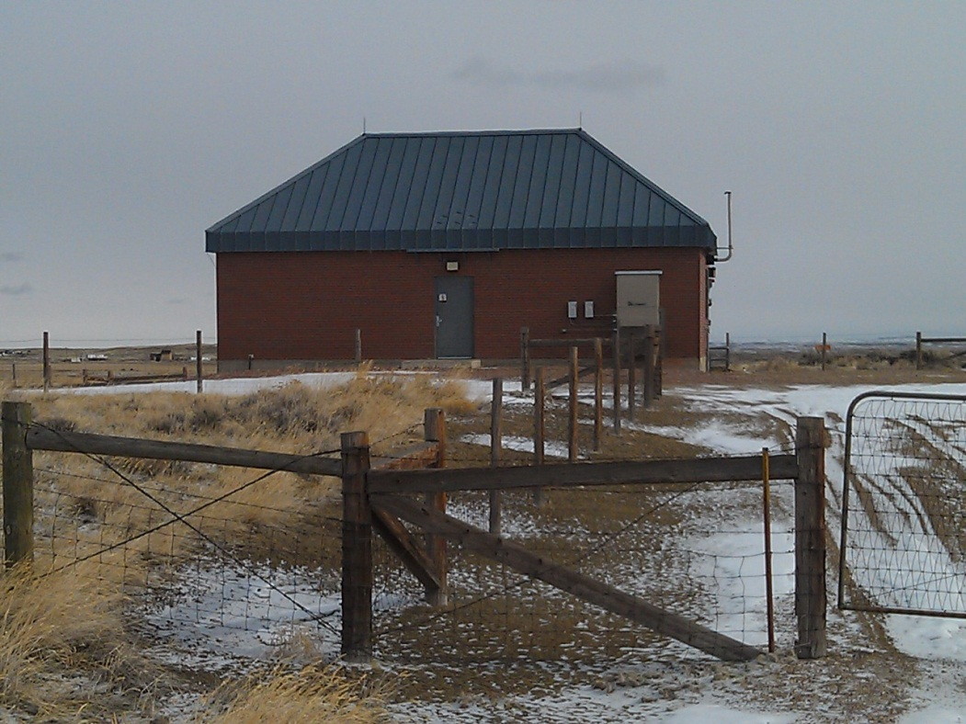
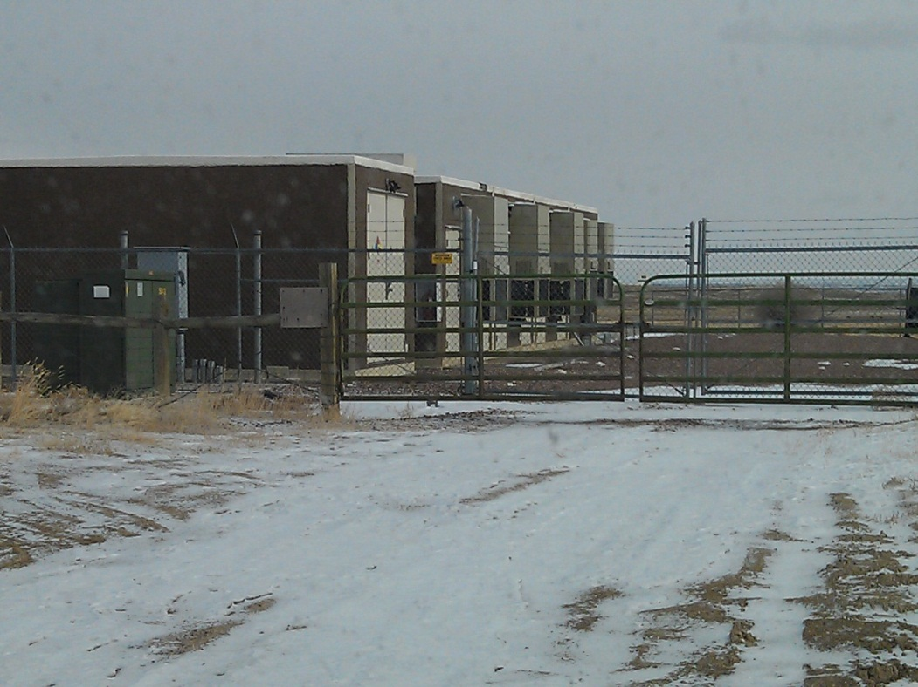
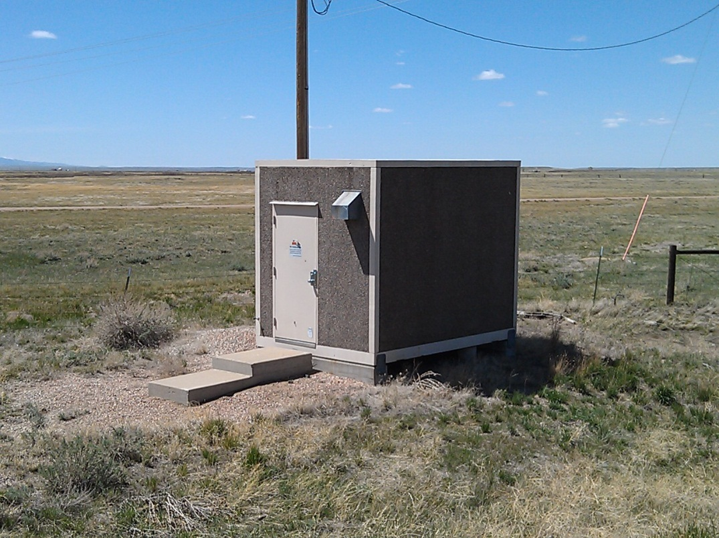
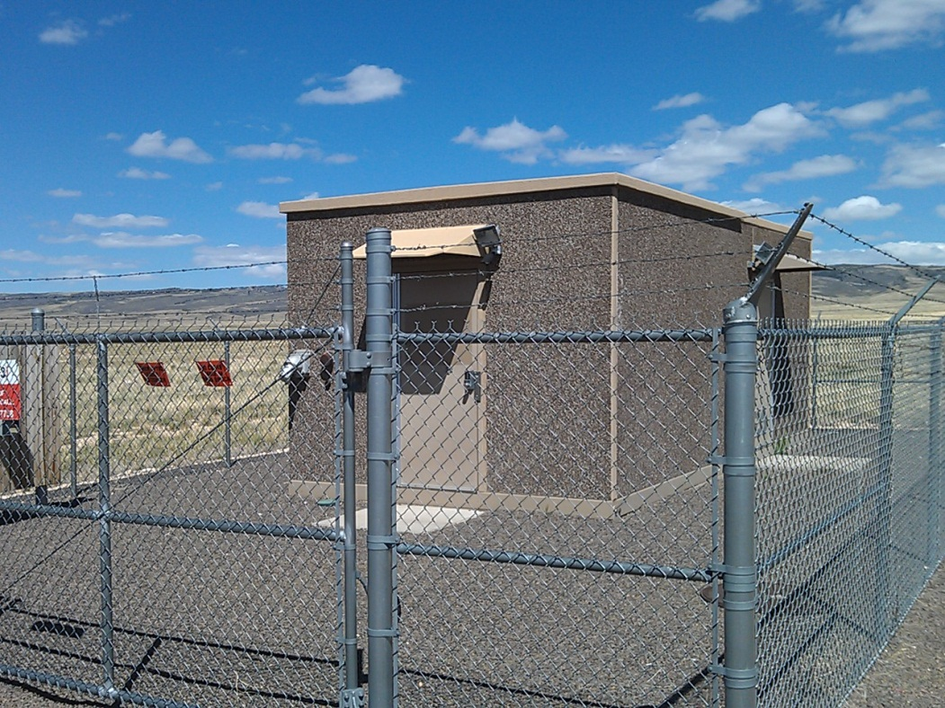
CenturyLink & AT&T 1st Routes
Level 3 Original Route
Sprint 8’ X 10”
UPRR & Howell Rd 7 miles north
Broadwing/Level3
Rogers Canyon Rd & Warren Ranch Rd

Slide 73
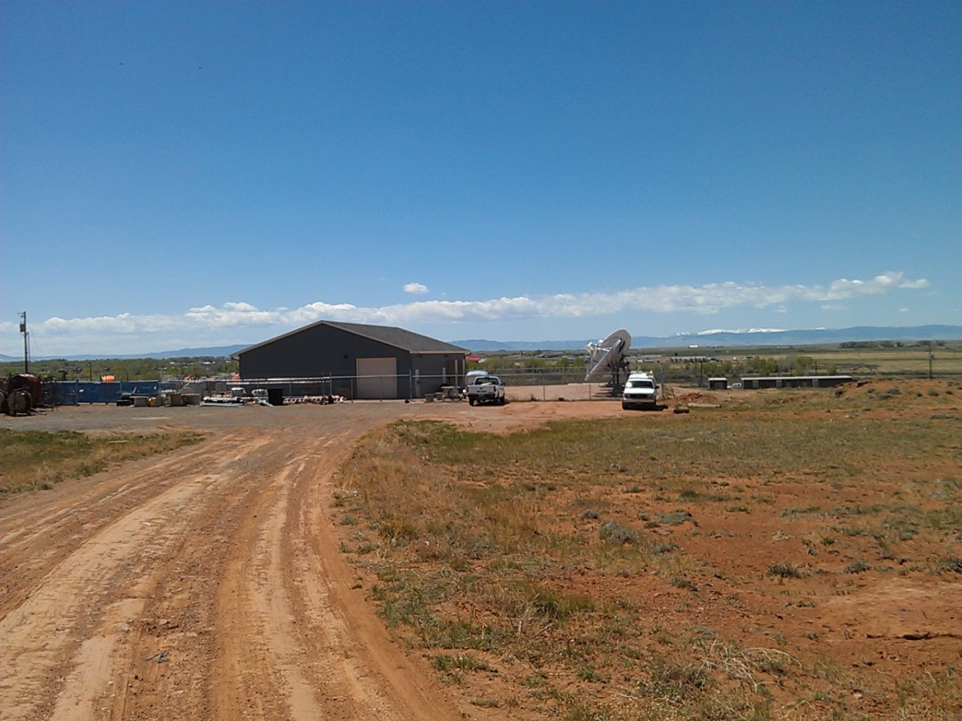
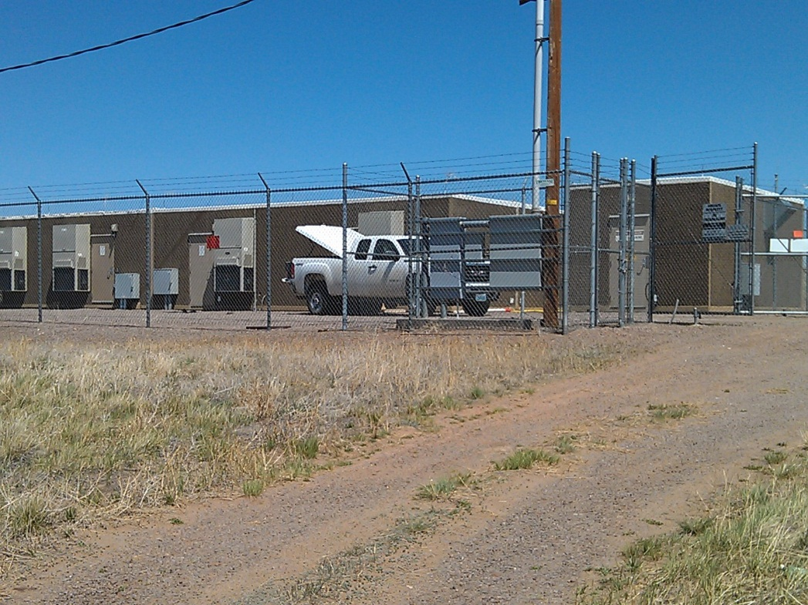
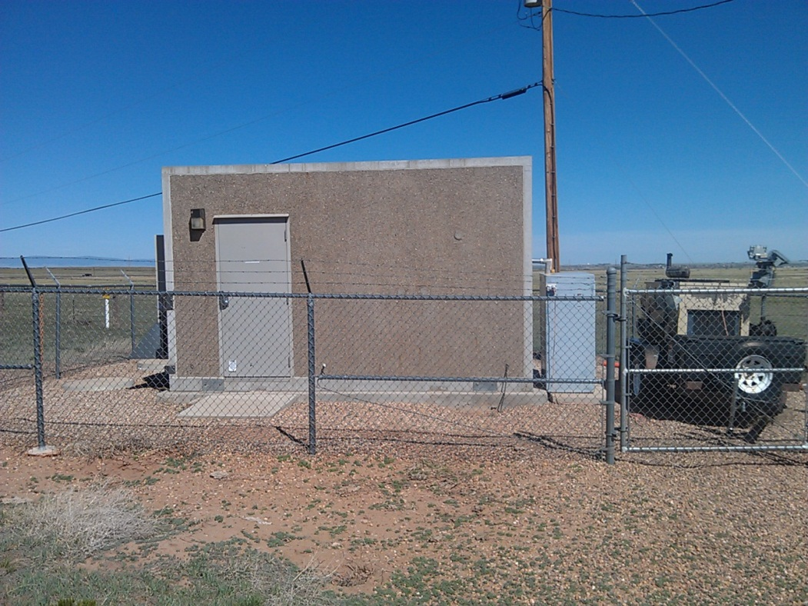
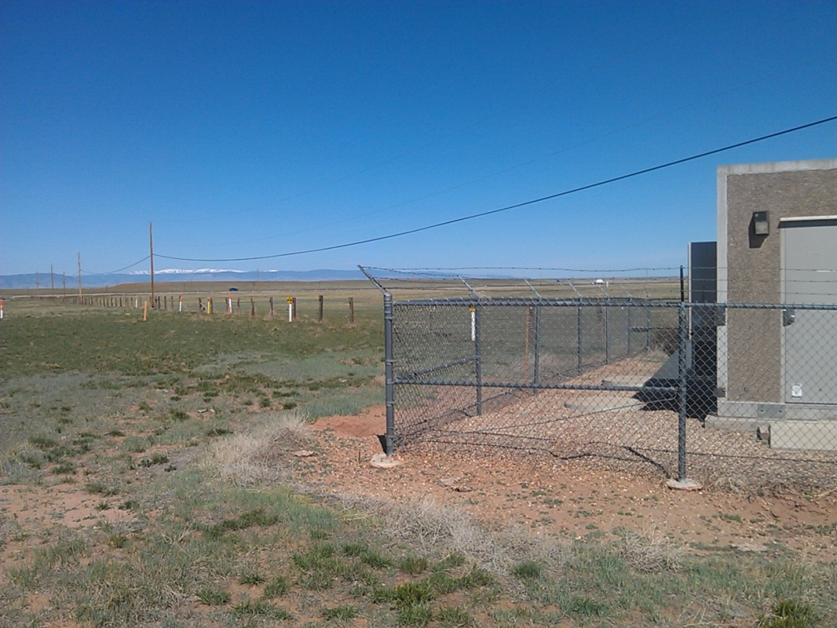
Optimum/Bresnan
287 near E Beaufort St
Original Level3
PFE Road
Wiltel & VzB Fiber Markers
Next to VzB Hut in Williams Pipeline
Verizon 8’ X 10’
287 S at Spring Lakes Rd

Slide 74
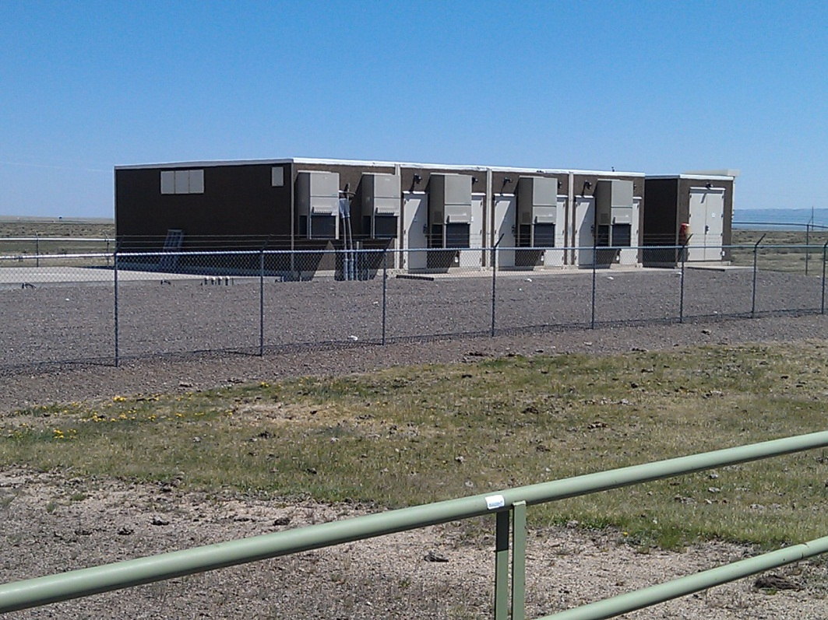
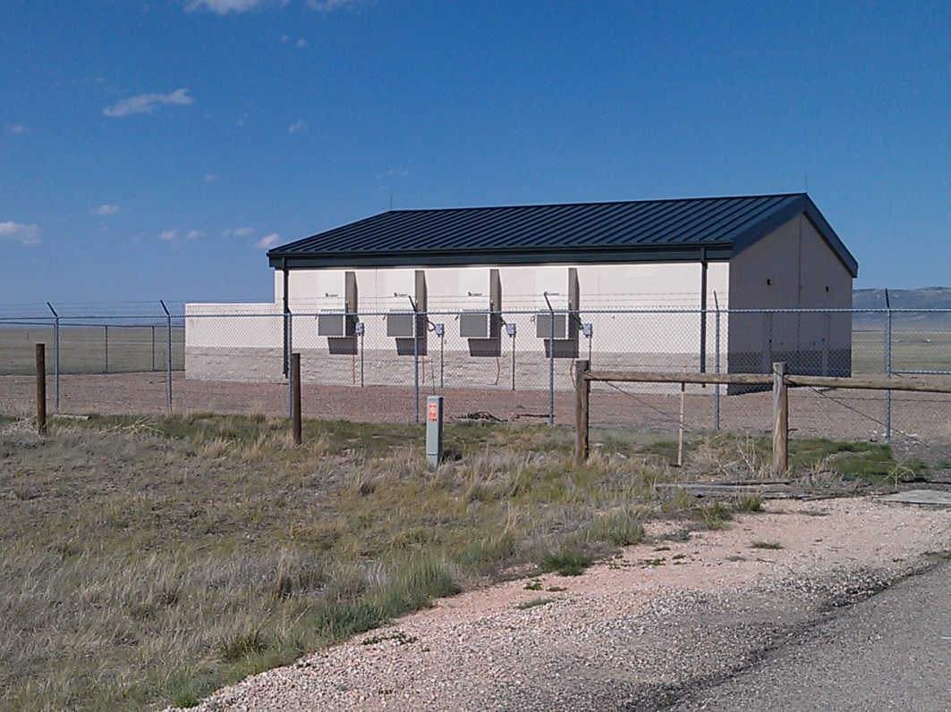
Wiltel 30’ X 20”
Herricks Road Exit on I80
CenturyLink/Enron ECI
287 – 10 Miles N of Bresnan

Slide 75
How are Huts or POPs Impacted by Adding Access ?

Slide 76
Definitions
CO = Telephone Company Central Office – Local Phone Switch
POP = Point of Presence – location where a carrier can pick up or deliver service(s)
Hut = a building where fiber is terminated to be amplified or regenerated along a route
Add/Drop = a location with equipment that will allow services to added or dropped – by installing add/drop equipment to a hut it would become a POP
Dark Fiber = fiber with no optical equipment connected to it.
Wavelength aka Wave or Lamda = distinct channel of “light” capable of carrying data over Fiber
Optronics = equipment used to “light” fiber for use
OC3 Lowest
Level of
Transmission
On Fiber

Slide 77
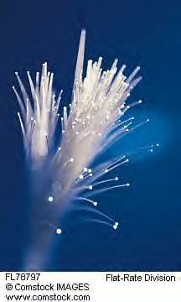
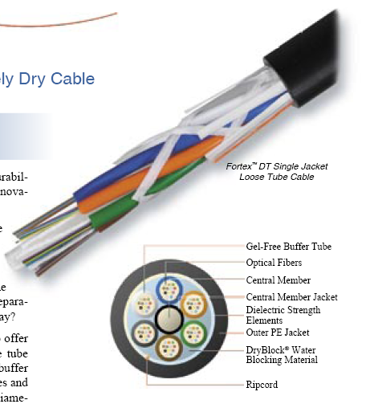

Slide 78
WEDA Conference
January 10th & 11th, 2016
Primary
Infrastructure Considerations
For Site Selection
Power
Broadband / Fiber
Water & Waste Water
Presented by:
Joseph “Joe” Sharkey
Independent & Semi Retired Consultant
801-201-2867
Joe.sharkey22@gmail.com
Co-owner Rocky Mountain Fiber (RMF)

